Slide 1
QAD Monitoring Framework
Systems Management for Effective QAD Operations
Brett Baumeister - Technical Solution Consultant, QAD

Slide 2
Safe Harbor Statement
Managing and Monitoring QAD Systems
The following is intended to outline QAD’s general product direction. It is intended for information purposes only, and may not be incorporated into any contract. It is not a commitment to deliver any material, code, functional capabilities, and should not be relied upon in making purchasing decisions. The development, release, and timing of any features or functional capabilities described for QAD’s products remains at the sole discretion of QAD.

Slide 3
Agenda
Managing and Monitoring QAD Systems
Application Performance Considerations
QAD Monitoring
Introduction
Key Features
Architecture & Technology
Case Study – QAD On Demand

Slide 4
Application Performance Considerations
Forrester Research has reported that among companies with revenue > $100 billion, nearly 85% reported significant application performance degradation
Best Practices in Problem Management

Slide 5
Application Performance Considerations
Nearly 85% of applications are failing to meet and sustain their performance requirements over time and under increasing load

Slide 6
The Impact of Poor Performance
Systems Management for Effective QAD Operations

Slide 7
How It Affects Your Business
Impact of Poor Performance
Lost productivity
Lost revenue
Low morale
Financial penalties
Customer escalations
Lost confidence and credibility across your Enterprise
Customers/Suppliers
End Users

Slide 8
Best Practice Targets
Managing and Monitoring QAD Systems
Keep the users and sponsors of the QAD software installation happy and productive
Up and down the supply chain
Reliability
Performance
Visibility
Reporting

Slide 9
Best Practices: Performance Engineering
Managing and Monitoring QAD Systems
Establish Performance Objectives
Identify Critical Requirements
Define Abnormal and Normal Conditions
Service Level Agreements
Create a Baseline
Continuous Monitoring and Alerting
QAD Monitoring Framework
Performance Tuning
Capacity Planning and Re-Sizing

Slide 10
Performance Objectives
Managing and Monitoring QAD Systems
Unless performance is actively managed and benchmarked, user performance expectations are hard to quantify.
“The system is running slow.”
“It takes too long to log in.”
What do these mean? Can we determine critical / objective requirements?

Slide 11
Establish a Baseline
Managing and Monitoring QAD Systems
Using KPIs and performance requirements
Create a set of baseline measurements
Capacity requirements planning &trending
Load testing tools may help with creating a baseline
Apache Jmeter
HP LoadRunner
QAD Monitoring

Slide 12
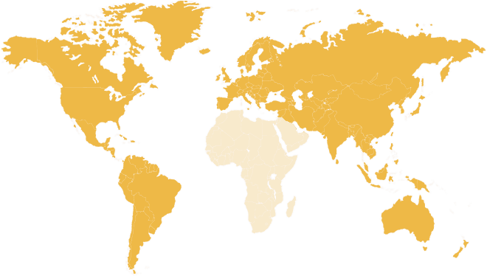
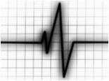
Our vision … new approach to software management and delivery
Streamlining the delivery and management of software
Development
Packaging
QAD Store
Fulfillment
Installation & Upgrade
Monitoring & Management

Slide 13
Are your proactive or reactive?
Monitoring QAD Systems
Ad Hoc Monitoring lacks transparency and can lead to emergency performance escalations
Continuous monitoring allows
Advanced notice of developing problems
Trending against the baseline
Extra information to aid in problem solving
The ability to deliver KPI information to management on demand

Slide 14
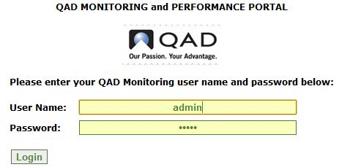
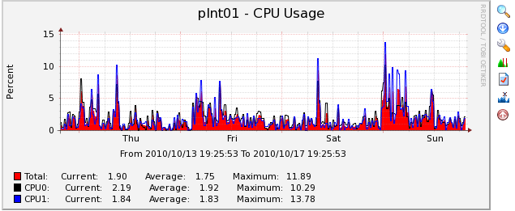
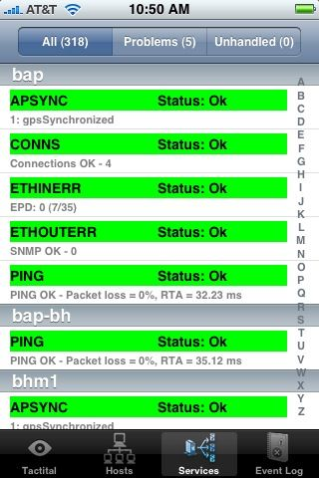
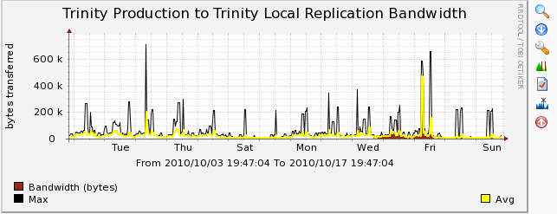
Introduction
QAD Monitoring

Slide 15
Key features
QAD Monitoring
Monitors availability and trends:
QAD application infrastructure (DB, Tomcat, AppServers)
Systems infrastructure (CPU, Network, Disks, OS)
Provides a holistic view of a customer system
Exception alerting
Technology agnostic
Embedded documentations and extensible wiki
Deployed as a virtual appliance (on Linux VM)
A framework of industry leading open source tools and software

Slide 16
Key Features – Trending and Graphing
QAD Monitoring
Allows graphing of numerical data for trending and analysis
Helps Identify Usage Patterns
Enables visual correlation of data
Gives visibility into system trends
Filter by time periods of 30m to 1 year

Slide 17
Key Features – Trending and Graphing
QAD Monitoring
Data Gathering
Customizable scripts to gather data
Built in SNMP support
“Spine” poller to access data sources and update graphs
Templates (community and QAD)
Graph, Data Source, Host
User Management
User and Role based management
Permissions by Graph, by User
Users can keep their own settings / preferences

Slide 18
Key Features – Alerts and Availability
QAD Monitoring
Whenever a pre-defined condition is met, an alert can be sent to one or more contacts
Email / Pager / Twitter / Phone / Chat
Warning, Critical and Unknown Alert Levels
Recovery Messages
Template Driven Definitions
Inheritance and Overrides
Scalable, Flexible
Stores Service Level Agreement data for reporting

Slide 19
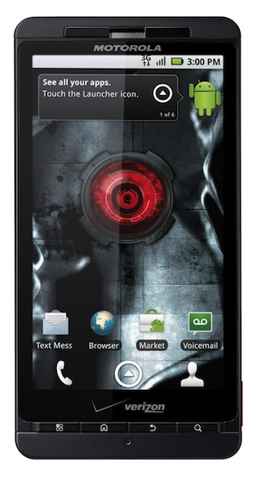
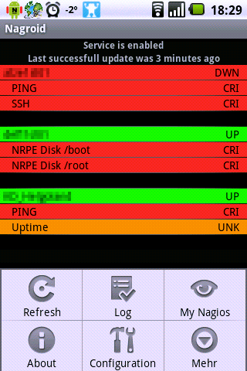
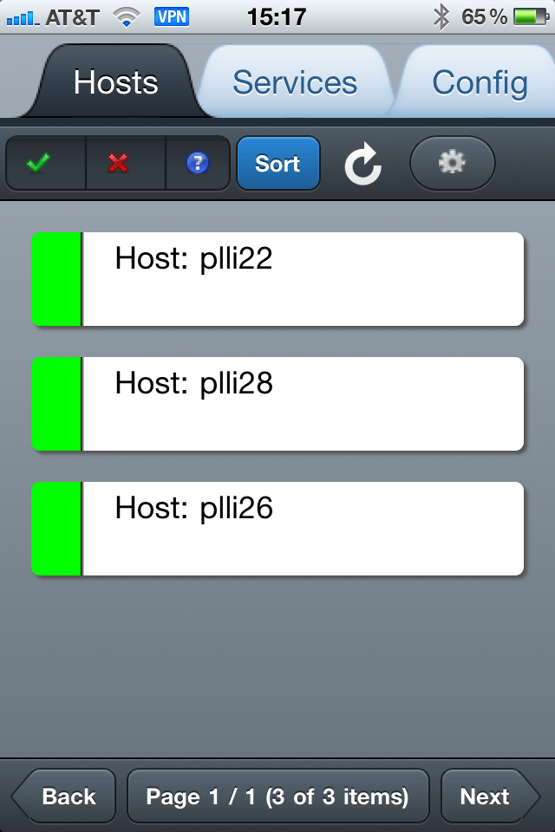
Key Features - Mobile Support
QAD Monitoring
* 3rd party apps
** webapp on appliance

Slide 20
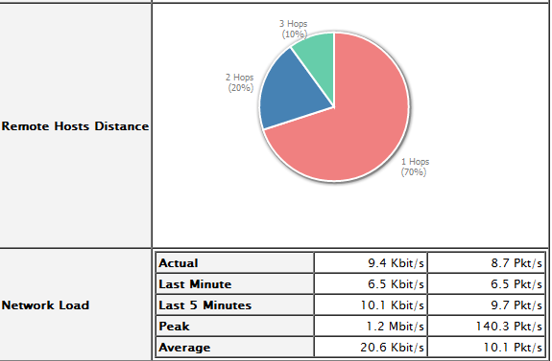
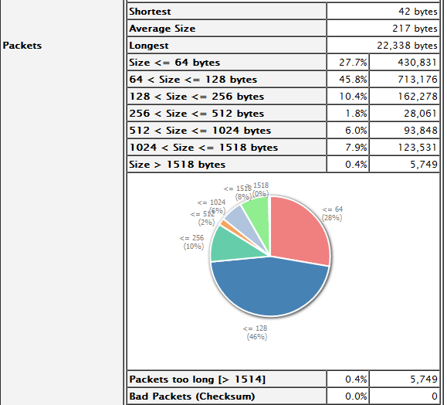
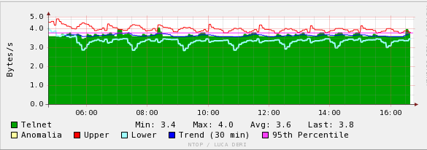
Key Features – Detailed Network Analysis
QAD Monitoring

Slide 21
Reporting and Service Level Agreements (SLA)
QAD Monitoring

Slide 22
Technology & Architecture
QAD Monitoring
Architecture
Technology

Slide 23
Deployment
QAD Monitoring - Technology
Deployed as a virtual appliance (Linux VMware image)
No Open Edge or commercially licensed components installed
ESX ready or VMware Server ready version
Security to monitored systems
Communicates with the monitored servers via trusted SSH relationships
Keys are stored on the VM and pushed to the remote servers

Slide 24
Integration
QAD Monitoring - Technology
Technology agnostic:
it does not care what is being monitoring
the flexibility to monitor practically anything
version independent
Integration templates for:
mapping to the QAD Architecture
Tomcat, Open Edge / other databases, Connection Manager, QAD business logic
any supported Operating System*
* windows support is currently limited

Slide 25
What QAD Monitoring is not
QAD Monitoring
QAD Monitoring is not a deep dive analysis tool to diagnose critical performance problems
That requires expert technical skill
Think of QAD Monitoring like regular checkups by your general practitioner
When something goes seriously wrong, consult a specialist

Slide 26
QAD On-Demand
QAD Monitoring
Issues with using multiple monitoring system

Slide 27
Challenge
QAD Monitoring – QAD On-Demand
Growing number of systems
Multiple monitoring solutions and tools
Management tools hitting limits
Labor intensive to provide uptime SLA reports
Poor alerting for a 24x7 global support team
Alerting didn’t account for timezones and working hours

Slide 28
Results
QAD Monitoring – QAD On-Demand
Global View of all QAD On Demand Deployments
Global View of new AMS customers
Single tool to train entire team quickly
Reduction in separate tools to monitor
Value to AMS and OD customers to help them understand the importance of QAD
Overall reduction in QAD resources required to monitor environments as now have single tool

Slide 29
Current monitoring statistics
QAD Monitoring – QAD On-Demand
On-demand customers
50
1500 Users
Servers
75
Environments
93
Service
2,590
Operating Systems
Linux
Windows
Notifications per day
300

Slide 30
Availability
QAD Monitoring Framework
Early Adopter
(August-September 2011)
Announced Explore 2011
(including technical session)
Generally Available
(Goal: October 2011)

Slide 31
Availability
QAD Monitoring Framework
QAD Monitoring will be available to customers who
Are on current QAD Maintenance
Invest in a technical Q-Scan
QAD Global Services engagement
Establish baseline system health
Tailor QAD Monitoring to their needs
Training

Slide 32
QAD Monitoring Contacts
Tony Winter (QAD CTO) tww@qad.com
Paul Newton (Project Manager) pln@qad.com
Derek Bradley (Architect/Consultant) dbb@qad.com
Don Springer (RF Product Manager) wds@qad.com
Brett Baumeister (PreSales Technical Consultant ) bbv@qad.com

Slide 33
www.qad.com
© QAD Inc

