Slide 1
7 (or more) Myths about Sales Tax and Nexus
Presented by:
Andrew Kim
Avalara

Slide 2
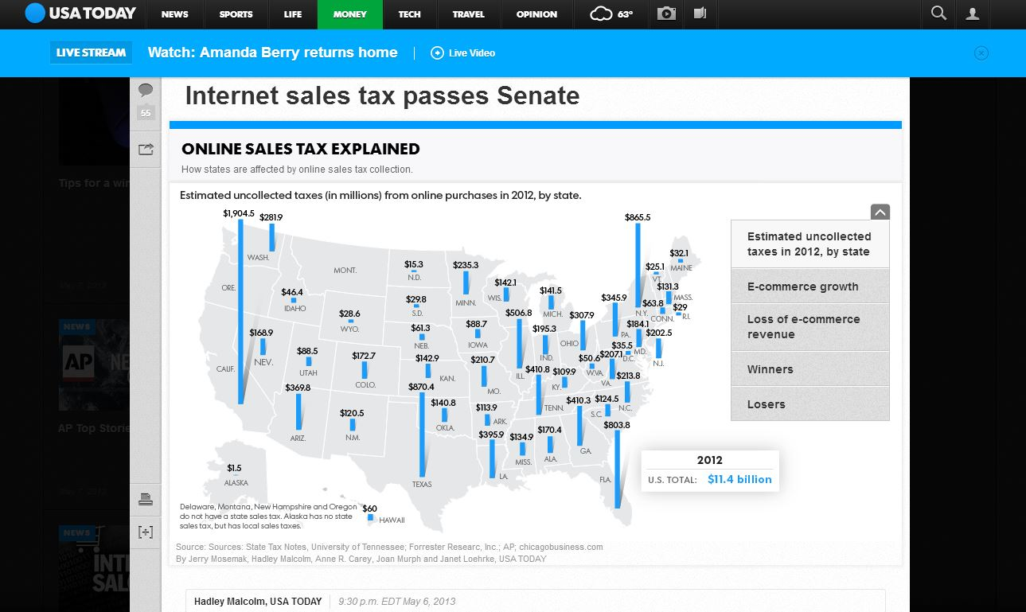
It’s In the News!
Marketplace Fairness*

Slide 3
Agenda
Background – A Wakefield Research Study on Sales Tax
Why Sales Tax Matters
Definition of Nexus
Truths or Myths
Recommendations
Questions

Slide 4

Wakefield Study Results
Finishing a Marathon is Easier Than Learning Sales Tax Compliance
52% of accounting professionals agree:
completing a marathon would be easier to accomplish than understanding sales tax compliance laws.
In your opinion, which of the following would be easier to accomplish?
Notes:
The Survey was conducted by Wakefield Research among 400 accounting professionals at companies with $1 million or more in total revenue, between July 12th and July 23rd, 2013, using an email invitation and an online survey.

Slide 5
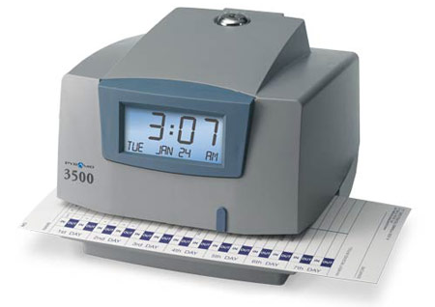
Wakefield Study Results
Too Much Time is Spent on Sales & Use Tax Compliance
On average, accounting professionals spend 11 hours a week filing sales tax returns and remitting payments. This is time that can be reclaimed and used elsewhere if your company automates the sales and use tax process.
Hours Spent | %
Less than an hour | 27%
1-5 hours | 25%
6-10 hours | 16%
11-20 hours | 14%
21+ hours | 20%
11:00
During a typical month, approximately how many hours per week
does your accounting team spend filing sales tax returns and remitting payments?

Slide 6


Wakefield Study Results
1 in 3 Companies Rely on “Existing Knowledge”
1 out of 3 (32%) accounting professionals say their company relies on “existing knowledge” to determine sales tax rates and taxability rules.
But state laws are consistently changing as jurisdictions search for ways to tax new products and technologies.
That makes the “existing knowledge” approach a dangerous one.
40% look up the rate on the state’s website
34% use an outsourced automated tax program integrated to your accounting/e-commerce system(s)
32% rely on “existing knowledge”
32% look up the rate using the 5-digit zip code
27% rely on outside tax professionals or consultants
17% treat all jurisdictions identically for taxability purposes
8% Other/use none of these
Which of the following methods, if any, does your company use to determine sales tax rates and taxability rules?

Slide 7

Wakefield Study Results
Audits Can Negatively Affect Office Culture
78% of accounting professionals who have worked for a company that has been audited, report negative effects to office culture.
The costs associated with an uncomfortable working environment can often be understated, but must not be overlooked.
Among those who have worked for a company that has been audited:
Which of the following, if any, happened as a result of your company’s audit?

Slide 8

Wakefield Study Results
Accounting Professionals Don’t Understand How Long an Audit Takes
On average, those who have worked for a company that has been audited, report the process took 39 days.
However, 76% of those who have never worked for a company that has been audited, think the whole process would be done in less than a month.
39 days
Among those who have worked for a company that has been audited: When your company was audited, approximately how long did the whole process last? Among all: If your company were audited today, approximately how long do you think the whole process would last?

Slide 9

Wakefield Study Results
Accounting Professionals Underestimate the Cost of an Audit
According to those who have worked for a company that has been audited, it costs $130,820 (on average) to manage an audit.
On the other hand, 84% of those who have never worked for a company that has been audited, think it would cost their company $100,000 or less.
$130,820
Among those who have worked at a company that has been audited: approximately how much did it cost, in total, to manage that audit? Among all: If your company were audited today, approximately how much do you think it would cost, in total, to deal with that audit?

Slide 10
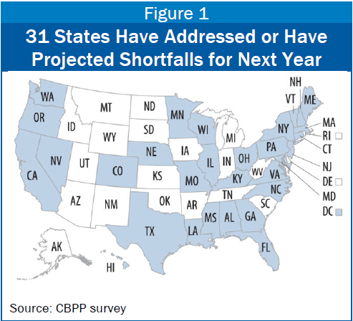
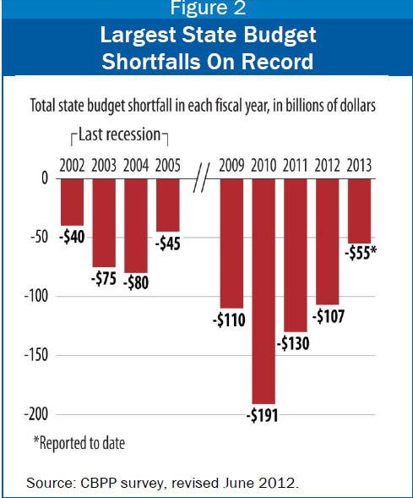
Why Sales Tax Matters

Slide 11
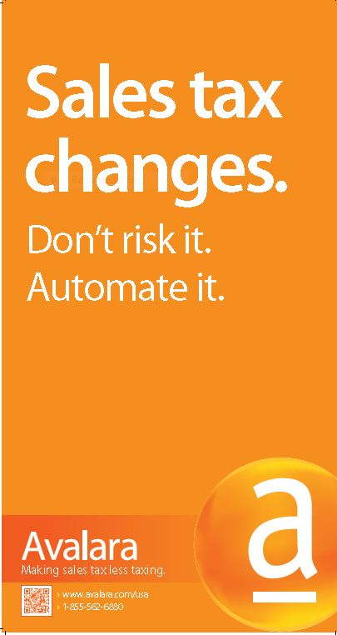
State News
Internet sales tax change could bring millions
to Illinois
The Southern Illinoisan 5/7/2013
NC Senate Republicans’ tax overhaul plan expands sales tax application
Fayobserver 5/8/2013
Mo. House backs income tax cut, sales tax hike
Hutchnews.com 4/26/2013
Latest Oregon tax overhaul: cut income tax, impose sales tax
The Oregonian 3/26/2013
Massachusetts Proposes Taxing Cloud Computing Services
Forbes 3/25/2013
Notes:
Theme- states are finding ways to collect revenue- NOT just for internet sales. Cut income tax, impose sales tax

Slide 12
States Taking Action
Idaho hired 48 new auditors in 2012
California going door-to-door in 13 counties AND hiring 100 additional auditors
Texas audits up 300% over 3 year period
States reviewing legislation for expanded tax on services (KS, LA, NE, NC, OK)
Washington state executing on obscure laws
States considering ‘economic nexus’
Collaborating with other states on audit findings
Notes:
California auditors
Mattress world
Clifford- Head tax services- collaborating w/ states on audit findings

Slide 13
Definition of “NEXUS”
Definition: A nexus in general means a connection. The term nexus is used in tax law to describe a situation in which a business has a "nexus" or presence in a state and is thus subject to state income taxes and to sales taxes for sales within that state. Nexus describes the amount and degree of business activity that must be present before a state can tax an entity's income. If a taxpayer has nexus in a particular state, the taxpayer must pay and collect/remit taxes in that state.
Presence in a state that obligates the seller to collect and remit sales tax.
Definition source: biztaxlaw.about.com
Notes:
Since state tax nexus can change from year to year as a result of administrative change, legislation or litigation, it can come as a surprise to even seasoned tax practitioners. Therefore it’s instructive to take a look at some of the areas in which the scope of nexus is increasing.

Slide 14
More fun with NEXUS
What Determines Nexus?
Different for income taxes and for sales tax purposes
For Sales Tax Purposes:
  Physical location in the state
  Resident employees
  Property (including intangible property) in the state
  Employees regularly solicit business
  ‘Affiliate’ relationships
Definition source: biztaxlaw.about.com
Notes:
For Income Tax Purposes
In general, nexus is created for income tax purposes if an entity derives income from sources within the state, owns or leases property in the state, employs personnel in the state in activities that exceed "mere solicitation," or has capital or property in the state. The requirements vary from state to state.
A nexus for state sales tax purposes has in the past required a physical presence of the taxing business in that state; most recently nexus has also been invoked in relation toaffiliates.
The issues relating to whether a business has a nexus in a state and is thus subject to the state's taxing authority is complex and each state views the concept of nexus differently.

Slide 15

Truth or Myth #1
Sales tax collection is required only in the state where a business is located
  Remote sales staff
  Owns/leases real property
  Maintains inventory
  Advertises in local media
  Provides services, support
  warranty and/or repairs
  Investors/Board members
  Tradeshow participation
  Affiliates
Notes:
http://www.journalofaccountancy.com/Issues/2010/Nov/20102904.htm
Discuss Idaho- New employee
the survey found that reimbursing sales staff for the costs of maintaining an in-home office would trigger income tax nexus in 25 states. Soliciting services for six or fewer days would trigger nexus in every state but Hawaii, Massachusetts, Oklahoma, Rhode Island, Vermont and Virginia.
Attending a trade show for 14 or fewer days is enough to trigger nexus in nine states, although California, New York City, and Texas each said they had a special exclusion for trade show participants. Conducting job fairs, hiring events or other recruitment activities would trigger nexus in 20 states.
Twenty-nine states said sales tax nexus would result for a corporation that makes remote sales into the state, and stores and ships items from an in-state distribution center. States reaching the opposite conclusions were Indiana, Maine, Nevada, Vermont and West Virginia. Eighteen states—one less than last year—said a remote vendor that enters into affiliate agreements with one or more residents in the state would trigger nexus if sales attributable to all such arrangements totaled $10,000 or more.
Source Accounting Today Bloomberg BNA 2013 Survey of State Tax Departments

Slide 16

Truth or Myth #2
Sales tax is required only on tangible items
  Illinois
    Software downloads, package or canned program
    Software modifications
    Photo finishing
    General material repair
    Service contracts
  Wisconsin
    Installation charges
    Repair services
    Labor for repair (some exceptions)
    Software downloads
    Membership fees
  Disclaimer: State laws change frequently and professional interpretations may be required to determine actual taxability.
Notes:
FTA 2007 Services Taxation Survey
New economy has changed the way we buy and use services. Digital downloads vs. media. Online access and even services,
States are looking at these more closely.
Events can be taxable
Shipping and freight services
Pet services

Slide 17
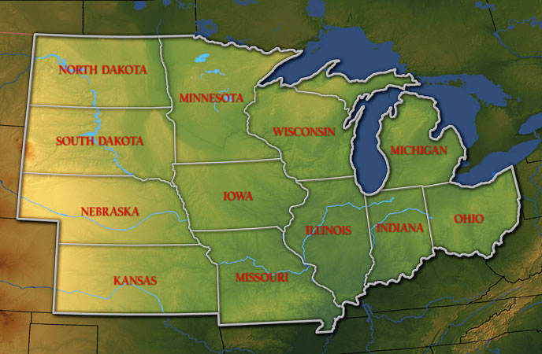

Truth or Myth #3
States cannot audit businesses unless they are physically located in their state
MYTH
Notes:
Cooperation between states too…

Slide 18
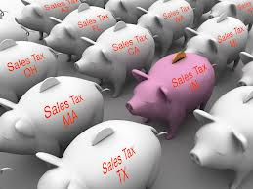
Truth or Myth #4
Sales and use tax rates are the same
  Usually, but not always
    AZ, CO, IL, and MO different rates
  Sellers use tax cannot exceed the sales tax rate

Slide 19
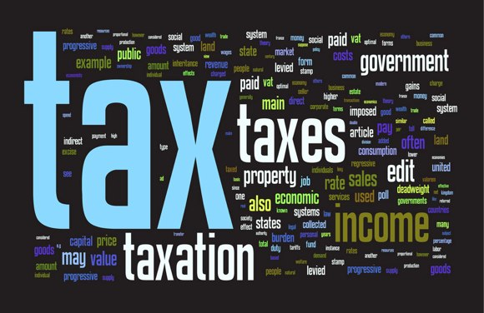
Truth or Myth #5
Income tax nexus and sales tax nexus are the same
MYTH
Notes:
In general, nexus is created for income tax purposes if an entity derives income from sources within the state, owns or leases property in the state, employs personnel in the state in activities that exceed "mere solicitation," or has capital or property in the state. The requirements vary from state to state.
Income, franchise and other business taxes. Having nexus for sales tax purposes does not necessarily mean a taxpayer will have nexus for income tax purposes, as a higher level of business activity may be required. Historically, state income tax nexus has been created when an out-of-state company derives income from sources within the state, owns or leases property in the state, or employs personnel who engage in activities that go beyond those “protected” under federal interstate commerce laws.
Additionally, in recent years several states replaced their income tax with non-income-based taxes. These include the Michigan business tax (MBT), the Texas margin tax (TMT), and the Ohio commercial activities tax (CAT). Like the Washington state business and occupation (B&O) tax and the Delaware gross receipts tax, the MBT, TMT and CAT are not based on or measured by income, but are imposed on gross receipts generated from the sale of products or services, the value of a business’s transactions or some other modified base.
Sales tax nexus is defined more loosely and is each state views the concept of nexus differently. It’s also changing across states as they adapt to our changed economy.
Recent state court decisions have expanded the power of states to tax the income of corporations with which they lack physical nexus. Each of these decisions found that an "economic nexus" existed between the taxing state and the out-of-state corporation. The courts determined that an out-of-state corporation's in-state economic presence made its lack of physical presence irrelevant. The income that the corporation derived from the state's market was subject to the state's corporate income tax.
The U.S. Constitution's dormant Commerce Clause limits the income tax a state can impose on companies lacking a substantial in-state physical presence. In Complete Auto Transit Inc. v. Brady, 430 U.S. 274, 279 (1977), the U.S. Supreme Court held that, if an out-of-state corporation's in-state activities create a "substantial nexus" with a state, the state can tax those activities.
http://www.journalofaccountancy.com/Issues/2010/Nov/20102904.htm
http://apps.americanbar.org/buslaw/blt/2006-05-06/snethen.shtml

Slide 20

Truth or Myth #6
The proposed internet tax is for online retail sales only

Slide 21
Truth or Myth #7
Only large companies with multiple sites in multiple states are at risk of a sales tax audit
  Audits on the rise
  Activities including:
    High exempt sales
    Late filings
    Dramatic change in sales
  Predictive modeling and scoring models
    Type of business
    Amount of sales
    Type of products
  Reporting from 3rd parties
Source: AICPA “The Tax Advisor” July 1, 2012
Notes:
With the increasing pressure to close budget gaps, state revenue departments must look for opportunities to revitalize their revenue streams. One way is to increase the number and scope of audits performed on taxpayers, thereby allowing states to collect more revenue without enacting new taxes or increasing tax rates. As a result, taxpayers are becoming the target of sales tax audits more frequently.
For some taxpayers, a sales and use tax audit is just another aspect of doing business. Due to their size and the nature of their business, some entities are placed on a regular sales tax audit rotation. For other businesses, however, a variety of factors may contribute to getting selected for an audit. An unusual event, such as a business closure or bankruptcy, may give rise to an audit. The compliance “personality” of a business may also trigger an audit. For instance, high exempt sales, poor compliance records with consistent late filings, a drastic change in sales, or a request for an unusually high refund may result in a sales tax audit.
To make the audit odds even greater, the current advances in technology, an increase in popularity of internet sales, and more small businesses’ partaking in multistate commerce create opportunities for sales tax underpayment among unwary taxpayers. Some states use random selection to identify audit targets. However, this method is uncommon since the financial result from a randomly selected audit may not justify the time and resources invested by the state tax authority. To maximize the return on an audit, many states implement predictive modeling similar to the Discriminant Index Function (DIF) system implemented by the IRS.1 With predictive modeling, different attributes—such as the type of business, amount of sales, types of products, and many other characteristics—are assigned a number. Generally, the higher the cumulative score, the greater the audit potential.
Since taxpayers are dealing with the reality of more audits, accounting firms and corporate tax departments should develop methodologies to reduce the administrative and other costs that result from the increased workload. This article pulls together tips and best practices for each part of an audit life cycle. After addressing tips, common issues facing state audits are discussed, followed by identifying potential opportunities to mitigate audits in the future. Several of these suggestions and opportunities should be useful for publicly practicing CPAs and taxpayers.

Slide 22

Truth or Myth #8
If a business is headquartered or located in a state that does not have a state sales tax, they are not liable to collect sales tax for other states
  Nexus determines sales tax requirement
  Mattress World - Oregon
Notes:
he recently disclosed she owes the state of Washington $1.7 million in uncollected sales taxes, interest and penalties, as well as $202,860 to the Internal Revenue Service for unpaid unemployment and payroll taxes.
Hiner says she thought by using third-party delivery firms she'd followed tax law, which requires retailers to collect sales taxes if they sell and deliver merchandise over the river. However, the law says retailers must collect sales tax if third-party delivery services cart mattresses inside a home and set them up -- something Hiner considered a key customer service.

Slide 23
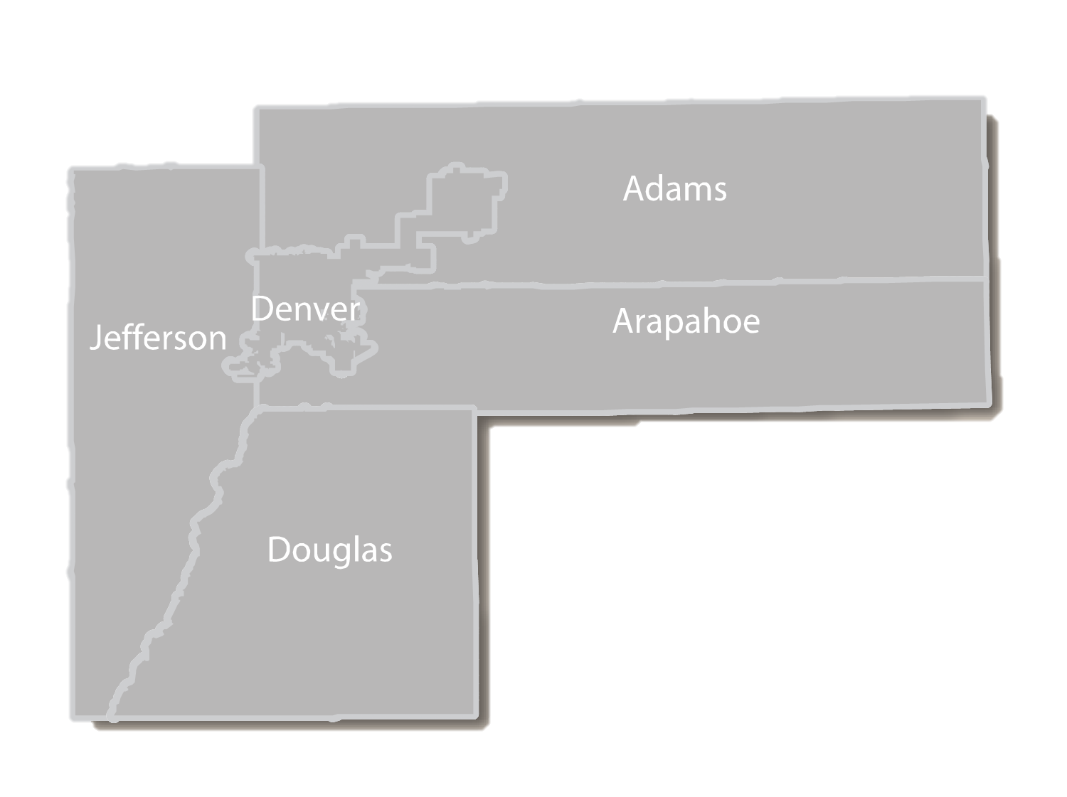
Truth or Myth #9
2.9% STATE
1.0% RT DIST
0.1% SCIENCE/CULTURE DIST
0.1% FOOTBALL DIST
0.25% ARAPAHOE COUNTY
4.35% TOTAL TAX
2.9% STATE
1.0% RT DIST
0.1% SCIENCE/CULTURE DIST
0.1% FOOTBALL DIST
3.62% DENVER
7.72% TOTAL TAX
2.9% STATE
1.0% RT DIST
0.1% SCIENCE/CULTURE DIST
0.1% FOOTBALL DIST
3.5% ENGLEWOOD
0.25% ARAPAHOE COUNTY
7.85% TOTAL TAX
2.9% STATE
1.0% RT DIST
0.1% SCIENCE/CULTURE DIST
0.1% FOOTBALL DIST
2.5% CENTENNIAL
0.25% ARAPAHOE COUNTY
6.85% TOTAL TAX
2.9% STATE
3.62% DENVER CITY
1.0% RT DIST
0.1% SCIENCE/CULTURE DIST
0.1% FOOTBALL DIST
7.72% TOTAL TAX
Notes:
Animates within one zip code to illustrate the various tax jurisdictions that apply.

Slide 24


How to protect your business
Understand your current processes
Document sales tax policies
Regular nexus analysis
Seek advice from local experts
Automate sales tax compliance

Slide 25
AvaTax from Avalara
AvaTax integrated into QAD
Both content and functionality
  Tax rates, taxability rules, boundaries
  Calculation, Filing, Remittance, Searchable
  Ongoing updates
Cloud-based solution
  Minimal set-up
  Short go-live
  No hardware and limited IT support required

Slide 26



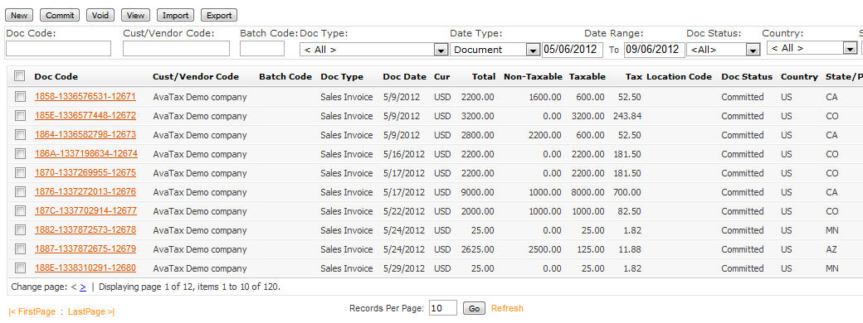
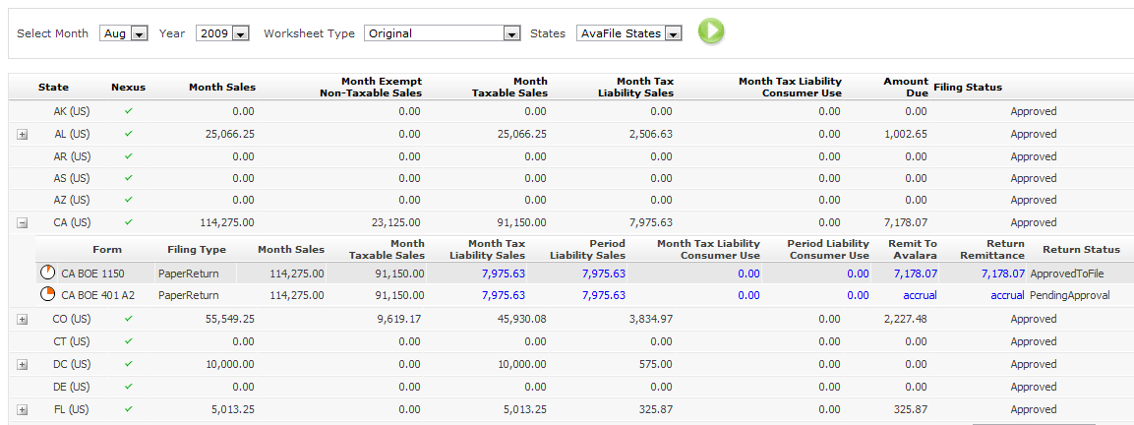
How It Works
Tax Rates
Tax Boundaries
Taxability Rules

Slide 27
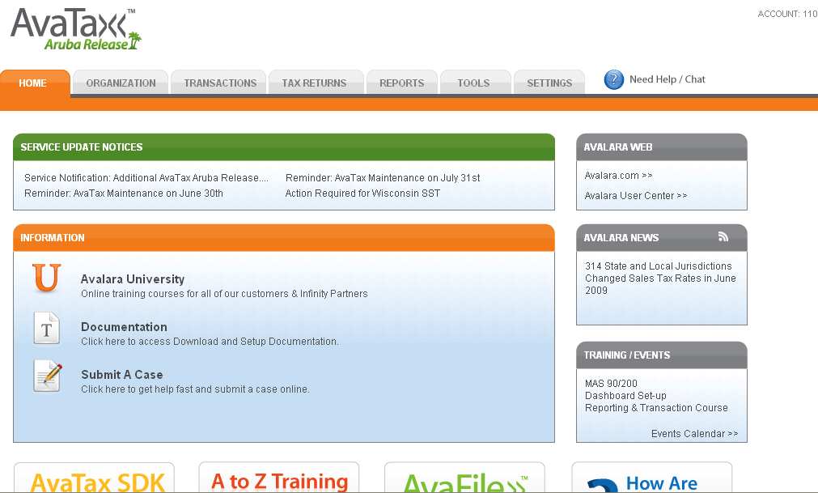
AvaTax Admin Console

Slide 28
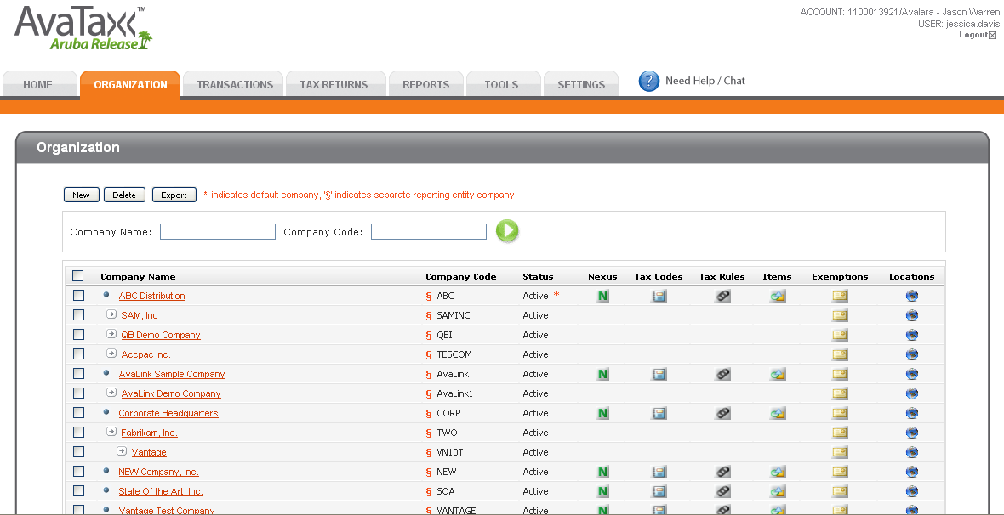
Organization

Slide 29
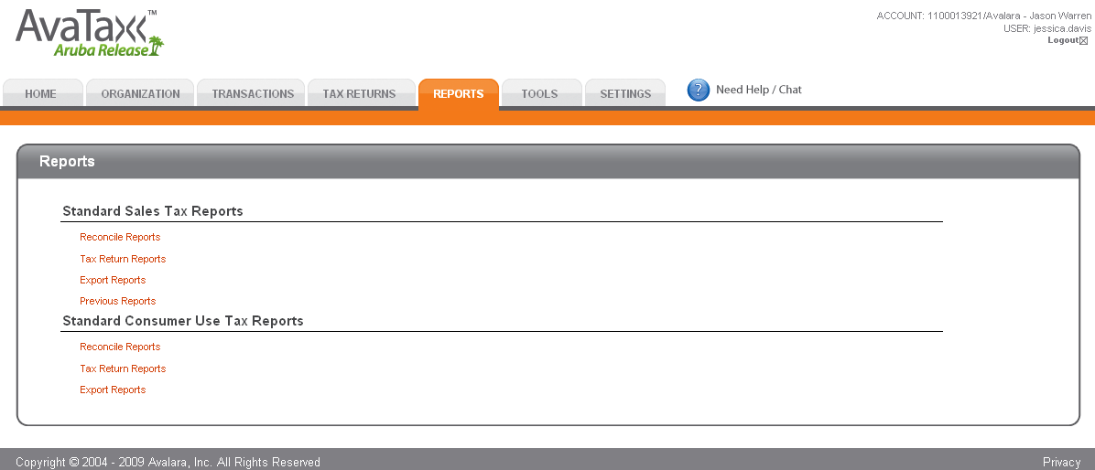
Reports

Slide 30
Questions
Andrew Kim
Regional Sales Manager
andrew.kim@avalara.com
714)383-0771

