Slide 1
Integrating QAD and The Quality Management System – A Customer Case Study
QAD Quality Management Webinar
April Dines, Corporate Quality Engineer, Cascade Engineering
Bob Herdoiza, President, CEBOS

Slide 2
Safe Harbor Statement
QAD Midwest User Group
The following is intended to outline QAD’s general product direction. It is intended for information purposes only, and may not be incorporated into any contract. It is not a commitment to deliver any material, code, functional capabilities, and should not be relied upon in making purchasing decisions. The development, release, and timing of any features or functional capabilities described for QAD’s products remains at the sole discretion of QAD.

Slide 3
Agenda
Integrating QAD and the Quality Management System
CEBOS Introduction
Cascade Engineering
Corporate Overview
Business Situation
Implementation
Benefits
Challenges
Future Goals
Q&A

Slide 4
CEBOS Overview
Integrating QAD and the Quality Management System
18+ Year Old Software Company
Management System Standards Focus
Division of QAD
Division Headquarters in Brighton, MI
Certified to ISO 9001:2008

Slide 5
Integrating QAD and the Quality Management System

Slide 6
Integrating QAD and the Quality Management System
Document Control
Training Management
Corrective Action / Nonconformance
Audit Management
Project Management
Gage Calibration
APQP, PPAP, Risk Management
Dashboard Reporting
Quality Data Collection
Supplier CAPA
Comply with quality standards (ISO, TS, AS, FDA, etc.)
Automate required business processes
Integrate related quality processes and QAD

Slide 7
CEBOS MQ1 Client Server
Integrating QAD and the Quality Management System

Slide 8
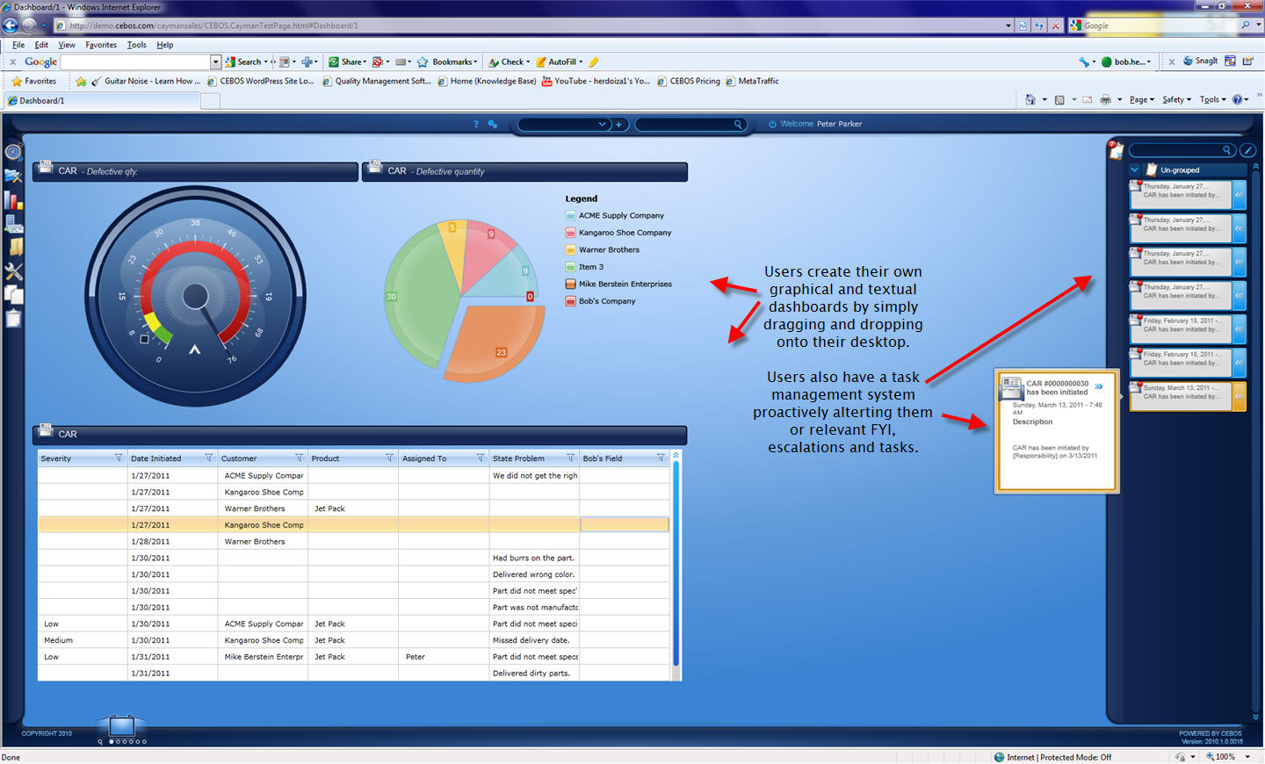
CEBOS’ MQ1 Elements
Integrating QAD and the Quality Management System

Slide 9
Integrating QAD and the Quality Management System
E-Sync
XML Integration Functional Description
Standard XML web services
Standard interface functions
Verification of receipt between services
Push/Pull Data
E-Sync Functional Description
Compare data source with MQ1
Add any missing records to MQ1
Update existing records in MQ1
Library of items to synchronize
System’s Integration Tools
Integration Toolkit
XML File Transfer

Slide 10
Driving Results
Integrating QAD and the Quality Management System
Incoming Inspection (QAD → MQ1)
Receiving triggers inspection
In-process Inspection (QAD → MQ1)
Move between operations triggers an inspection
Defect Log to inventory (MQ1→QAD/QAD→MQ1)
Recording a defect moves material to MRB in QAD
Material is moved to MRB, a defect is created

Slide 11
Integrating QAD and the Quality Management System
Driving Results
Customer Complaint
Complaint call logged in QAD, CAPA created in MQ1
Training Check
Operator training validation check before work
Calibration Check
Gage calibration validation before can use in QAD

Slide 12
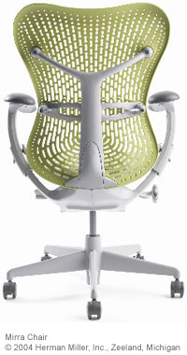
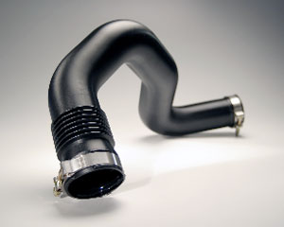
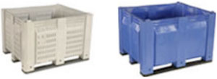
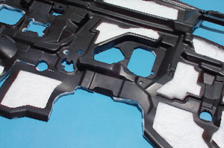
Case Study – Cascade Engineering
Integrating QAD and the Quality Management System
Decade Bins
Airtubes
Seatbacks
Hydraid Filters
Carts
Dashmats
Carts

Slide 13
CE - Business Situation / Gaps
Integrating QAD and the Quality Management System
No integration with QAD (dual entries)
System not intuitive
Wasted time modifying reports
Stand alone systems for launches / changes
No triggers for tasks due / manual follow up
Manual completion of tasks for supplier's
Manual tracking of data collection
No linkage between systems
Lack of visibility

Slide 14
CE – Module Selection
Integrating QAD and the Quality Management System
E-Sync (integration)
Documents
Gage (calibration)
Problem Solver (corrective actions)
APQP (customer product approval)
Work Manager (product launches)
Data Collection
Audits
Supplier Portal

Slide 15
CE – Goal Implementation Time
Integrating QAD and the Quality Management System

Slide 16
CE – Immediate “Wins”
Integrating QAD and the Quality Management System
Documents
Gages
Audits
Data was migrated
Easy setup / minor modifications
Limited number of power users
Fast training

Slide 17
CE – 1-2 Year Progression
Integrating QAD and the Quality Management System
Problem Solver
CPR Templates
Quality Bulletins – deviations / quality alerts
Work Manager
Project Templates
Development of templates / reports
Many users
More complicated / longer training

Slide 18
CE – Long-Term / Overall Benefits
Integrating QAD and the Quality Management System
Linkage between modules
Saved time
Greater management awareness
Auto follow up / escalation
Anticipate less audit findings
Finding other applications for improvement
Records
Gage R&R
Meetings
Intuitive – people want to use it
Total Expected Savings:
3583 | hours / year
448 | days / year

Slide 19
CE - Challenges
Integrating QAD and the Quality Management System
Work Manager – large projects
Longer to make changes - delays
Dependencies difficult
Cannot import from Microsoft Project
Data collection setup
A lot of setup time / job (600 checks)
Many users – training time
On-going
APQP
Time to populate libraries / job
Difficult to understand / train others
Customer specific PPAP requirements
On-going

Slide 20
CE – Future Goals
Integrating QAD and the Quality Management System
APQP development
Data collection plans
Use of records
Setup manuals
Documenting meetings
Gage R&R’s

Slide 21
Questions & Answers
Integrating QAD and the Quality Management System
April Dines, Cascade Engineering
Bob Herdoiza, CEBOS

Slide 22
Next Steps
Integrating QAD and the Quality Management System
Contact your account representative
www.cebos.com
810.534.2222
bob@cebos.com

Slide 23
Integrating QAD and the Quality Management System
www.qad.com
© QAD Inc

