Slide 1
Production Scheduling: What Tool is Right for You?
MWUGSpring2013
Stephen Dombroski – Sr. Mgr. Marketing - Manufacturing Industries, QAD
Jason Scott – Partner, MPS Associates

Slide 2
Agenda
Production Scheduling: What Tool is Right for You?
Tools for the Planning and Scheduling process
How do these tools work together?
Which tools are right for you?
QAD Tools for Planning and Scheduling
Preactor Tool for Planning and Scheduling
Questions and Answers

Slide 3
Planning Process Overview
Production Scheduling: What Tool is Right for You?
Financial
Demand
Planning
Execute
Execute
Production
Planning
Procurement
Order
Fulfillment
Production
Scheduling
Supplier
Materials
Requirements
Planning
Customer
Electronic Commerce

Slide 4
Planning and Scheduling Tools/Concepts
Production Scheduling: What Tools is Right for You?
Demand Planning/Forecasting
Convert field sales requirements
MRP – Materials Requirements Planning
Plan for material availability (WIP and Raw Materials)
Production Planning/Master Scheduling
Capacity/Labor Constraints
Multiple points of supply
Seasonal builds
Sequence dependent setups
Production Scheduling/Detailed Scheduling
Schedules by product and resource
Changeovers and setup sequencing

Slide 5
Why Use Planning Tools
Production Scheduling: What Tool is Right for You?
ERP Systems – QAD Demand Planning and MRP
ERP Systems - If you need it, they can make it
Consolidate field sales requirements into periods
Manage and track inventory levels
Manual changes to resolve issues
Finite Capacity Planning/Scheduling – QAD Workbenches
Ability to schedule within capacity limits
Visual Planning and Scheduling
Manually adjust schedule to meet demand
Advance Planning and Scheduling (APS) – Preactor
Complex Operations
Multiple production stages
Optimization needed to sequence operations

Slide 6
When to Use What Tools and When
Production Scheduling: What Tool is Right for You?
Multiple SKU’s, Complex BOM’s
Preactor
Complex Demand, Seasonality
QAD Workbenches
Steady Demand Pattern
Few SKU’s, Simple BOM’s
QAD Enterprise Applications
Single Plant
Multiple Locations
Simple Production Process
Complex Process, Multiple Steps, Multiple Production Sequences

Slide 7
Forecasting
Production Scheduling: What Tool is Right for You?
Business Needs
Determine demand
Plan production req’s
Inventory builds
Purchasing req’s
Transportation req’s
Warehouse planning
ASN planning
Functionality
Base forecasting
Forecast simulations
Forecast to MRP
Forecast horizon
MRP horizon
Consumption logic
Historic data

Slide 8
QAD Enterprise Apps General System Flow
Production Scheduling: What Tool is Right for You?
Production Forecast
Sales Orders
(Demand)
MRP
Calculation
Manufacturing
Supply
Invoice Posting
Exact
History
Forecast
Simulation
Calculation
Sales
History

Slide 9
Materials Requirements Planning
Production Scheduling: What Tool is Right for You?
Business Needs
Right product
Right place
Right time
Project inventory levels
Location inventories
Planned orders
Auto release
Functionality
Time phased
Priority planning
Projected inventory
Planned orders
Materials req’s
Action messages
Utilizes
Product Structures
Inventory Status
Master Schedule
Open Order Dates

Slide 10
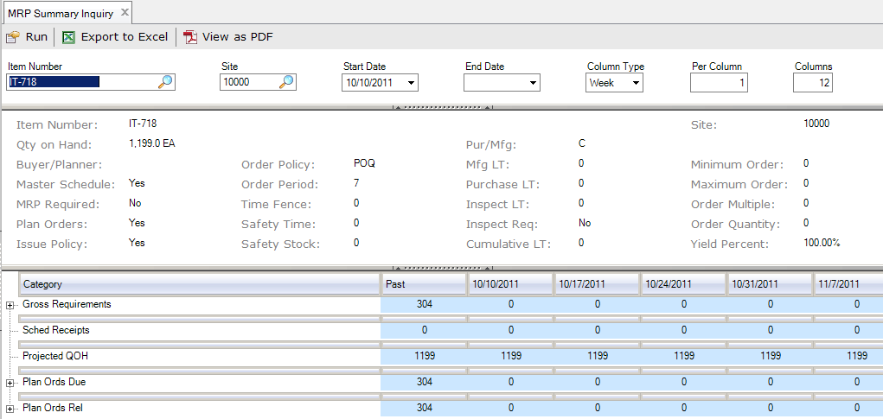
Production Scheduling: What Tool is Right for You?
QAD MRP – MRP Summary Screen

Slide 11
Production Scheduling: What Tool is Right for You?
QAD MRP – Action Messages

Slide 12
QAD Planning and Scheduling Workbenches
Production Scheduling: What Tool is Right for You?
Integrated view of key planning and scheduling data elements
Ability for quick visibility to:
Supply and demand issues
Machine capacity issues
Material shortages
.. leading to a higher rate of schedule achievement
.. improving delivery schedules
.. helping reduce inventory levels

Slide 13
Scheduler’s Challenge
Production Scheduling: What Tool is Right for You?
Executives
ROI must improve; the stockholders are not happy!
Finance
There’s too much cash tied up in inventory!
Manufacturing
There are too many changes! Provide fixed schedules and the correct parts and delivery will improve.
Engineering
There’s a new product introduction scheduled for the fall! But we need more time for design!
Sales
Service levels are down. I need more inventory! Whatever it takes to keep the customer happy!

Slide 14
Planning and Scheduling Paradigm
Production Scheduling: What Tool is Right for You?
Planning
Data
Forecast
POs
BOMs
Routings
WOs
QOH
Work
Centers
Capacity
Safety Stock
Shop Calendar

Slide 15
QAD Solution
Production Scheduling: What Tool is Right for You?

Slide 16
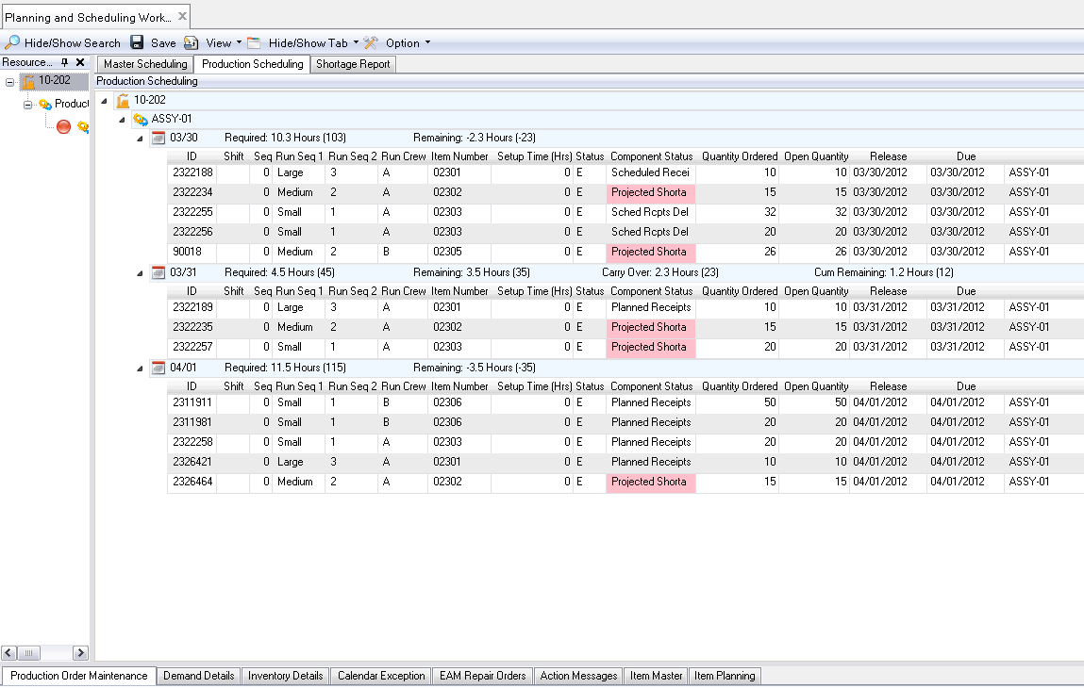
QAD Solution
Best Practices in Planning and Scheduling

Slide 17
Solution Components Tied Together
Production Scheduling: What Tool is Right for You?
Months-Weeks-Days | Days | Day-Shift-Intervals
Master Scheduling
Production Scheduling
Release To shop Floor
Execution
Master Schedule Workbench (MSW)
Production Scheduling Workbench (PSW)
Maximize production efficiency through schedule optimization
Release to production with verification of available materials
Create a master schedule balanced to supply / demand / resources
Component Available Check (CAC)

Slide 18
What is Preactor Finite Capacity Scheduling?
Production Scheduling: What Tool is right for You?
Plot work load against preconfigured shift calendars
Maintain Operation to Operation Relationships
Utilize Resource Group Options
Sequence by Priority, Due Date or Predefined File Order
….. AUTOMATICALLY

Slide 19
What is Preactor Advanced Planning and Scheduling?
Production Scheduling: What Tool is right for You?
Consider Materials as a constraint during the scheduling process
Maintain PO to WO, WO to WO and WO to SO Relationships
Utilize Secondary Constraints to model the all related factors (labor, tooling, etc)
Employ advanced scheduling rules to target specific goals (minimize setup/WIP, Parallel Load, Dynamic Bottleneck)
….. AUTOMATICALLY

Slide 20
Typical Process Flow when using Preactor for QAD
Production Scheduling: What Tool is right for You?
Import QAD Order Data
Sequence production requirements using fully constrained Preactor model
Collaborate with Operations, Materials and Sales making necessary adjustments
Export Data updating QAD Work Order Release/Due Dates and Resource assignments

Slide 21
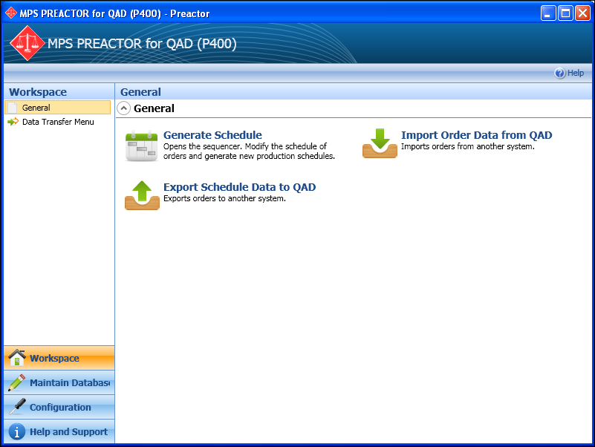
Preactor Interface
Production Scheduling: What Tool is right for You?

Slide 22
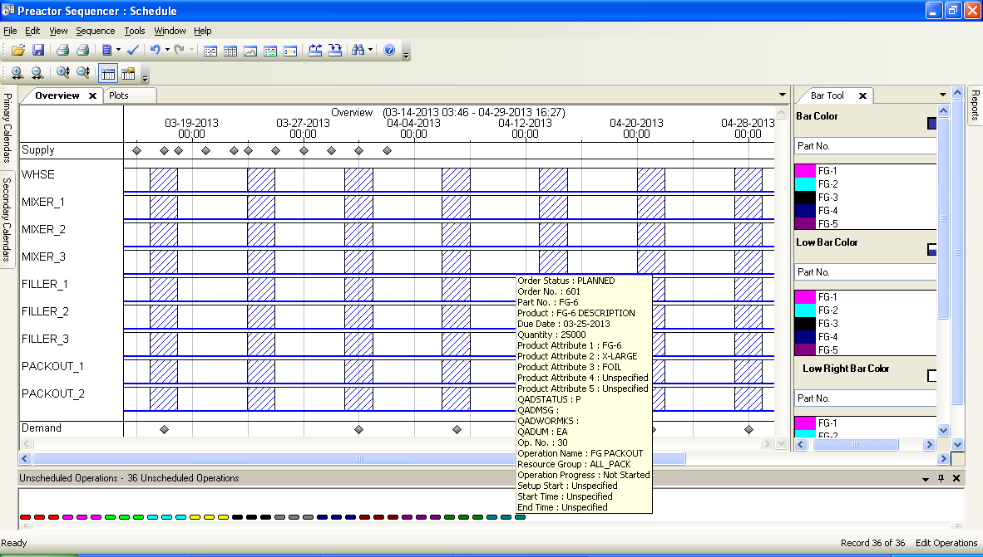
Preactor Overview Window or Scheduling Board
Production Scheduling: What Tool is right for You?

Slide 23
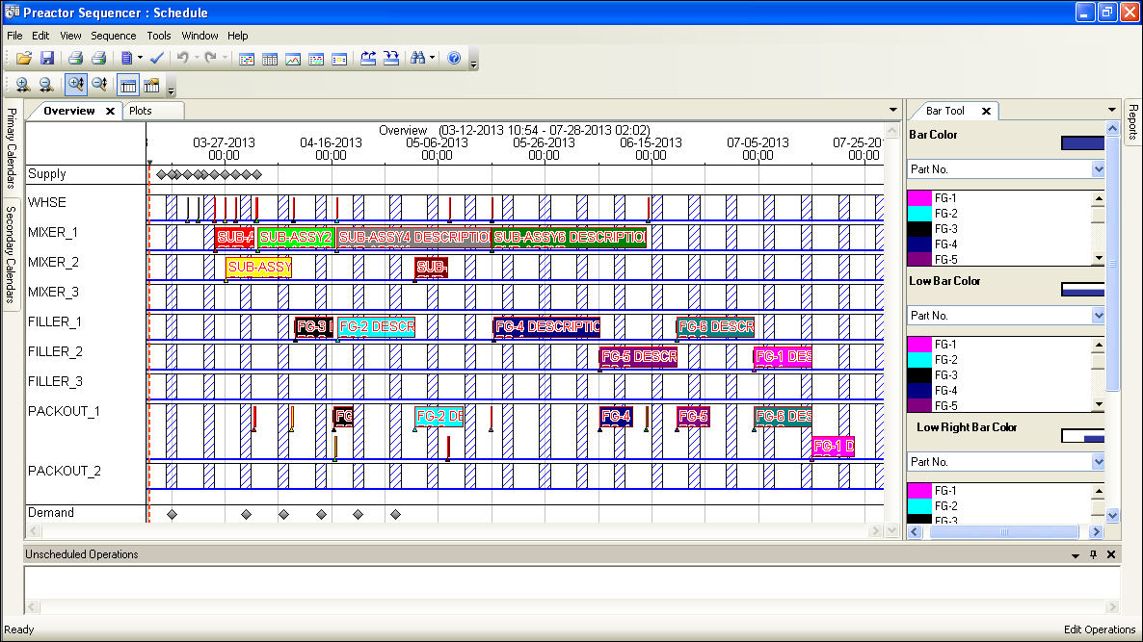
Preactor Overview Window or Scheduling Board
Production Scheduling: What Tool is right for You?

Slide 24
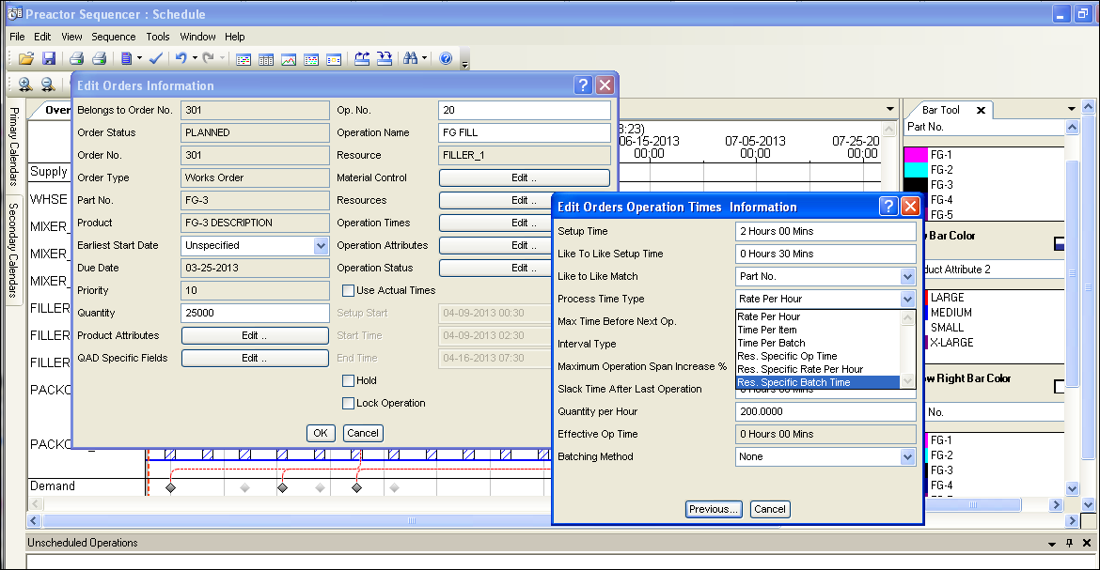
Operation Detail View
Production Scheduling: What Tool is right for You?

Slide 25
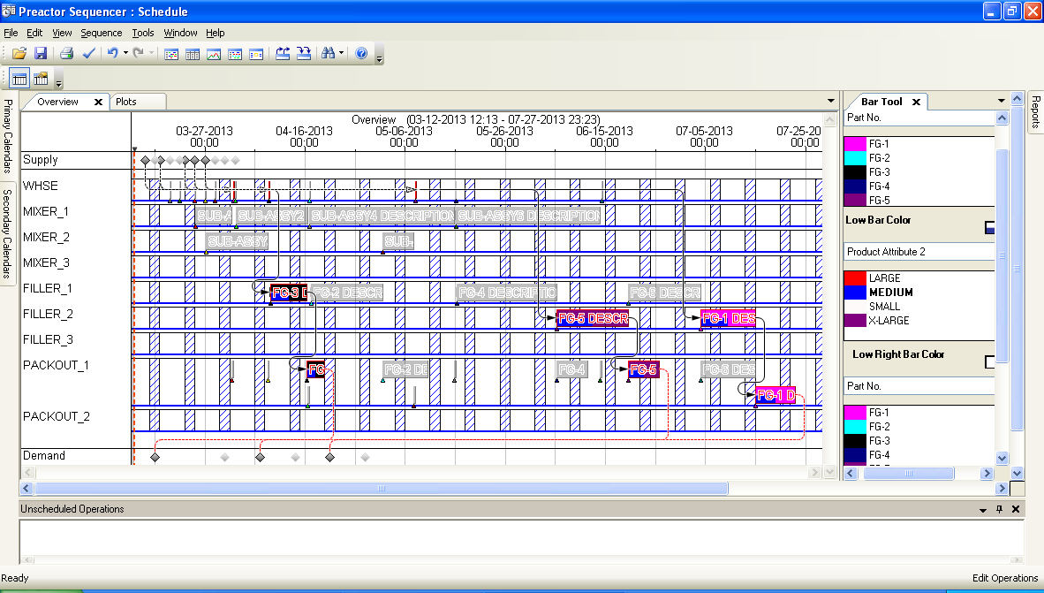
Using Color Highlights to View Sequence (select MEDIUM Prod Attr 2 to highlight all operations)
Production Scheduling: What Tool is right for You?

Slide 26
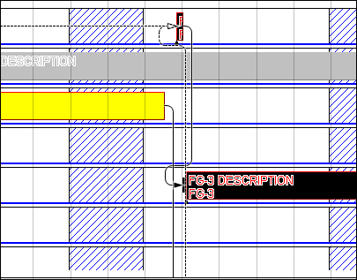
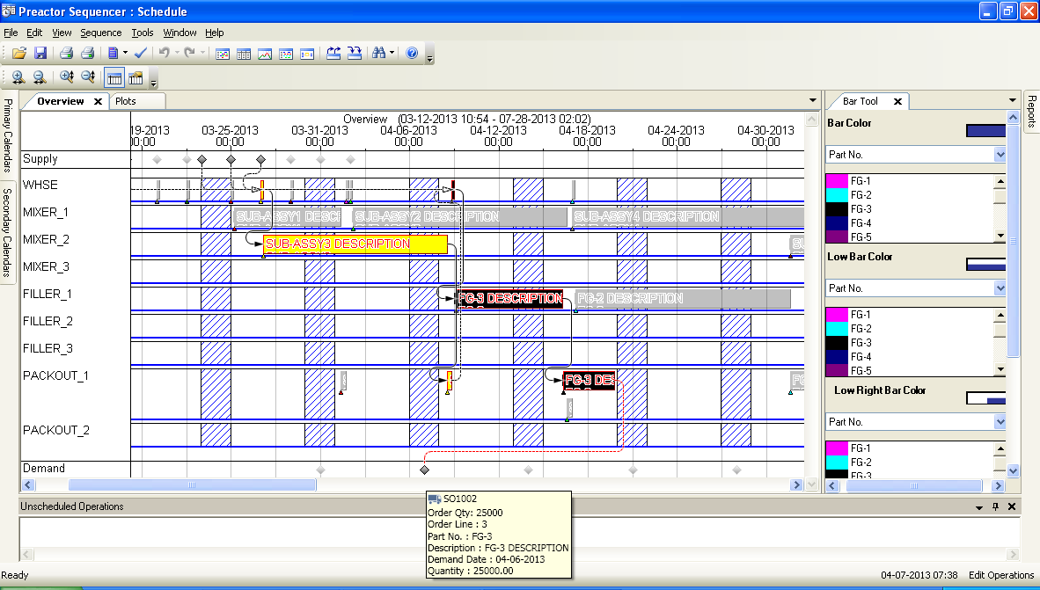
Multi-Level Pegging
Production Scheduling: What Tool is right for You?

Slide 27
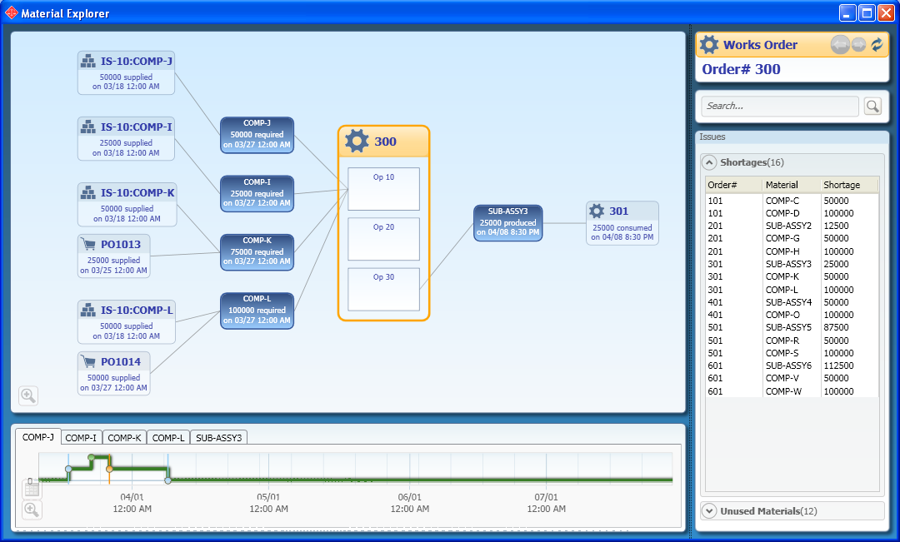
Multi-Level through Material Explorer View
Production Scheduling: What Tool is right for You?

Slide 28
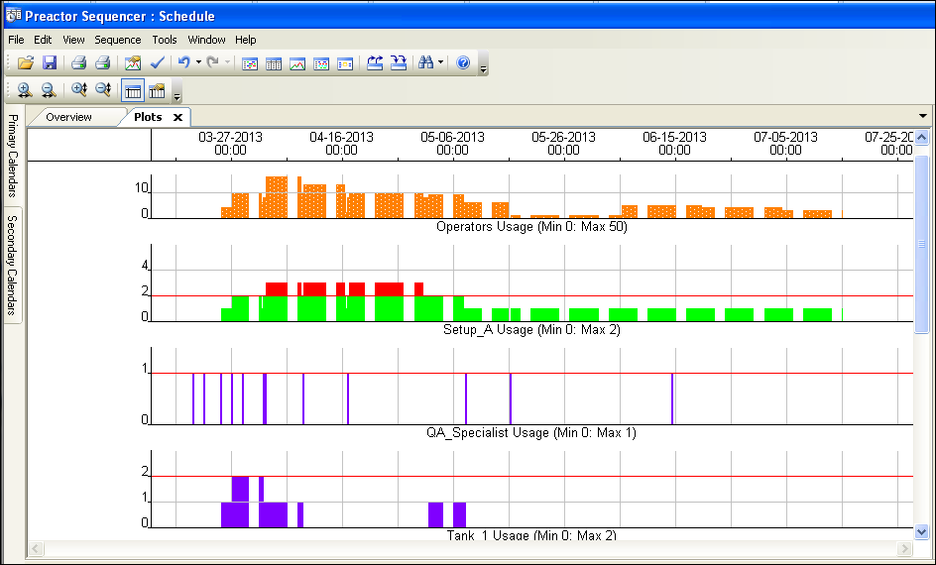
Plot View of Secondary Constraints
Production Scheduling: What Tool is right for You?

Slide 29
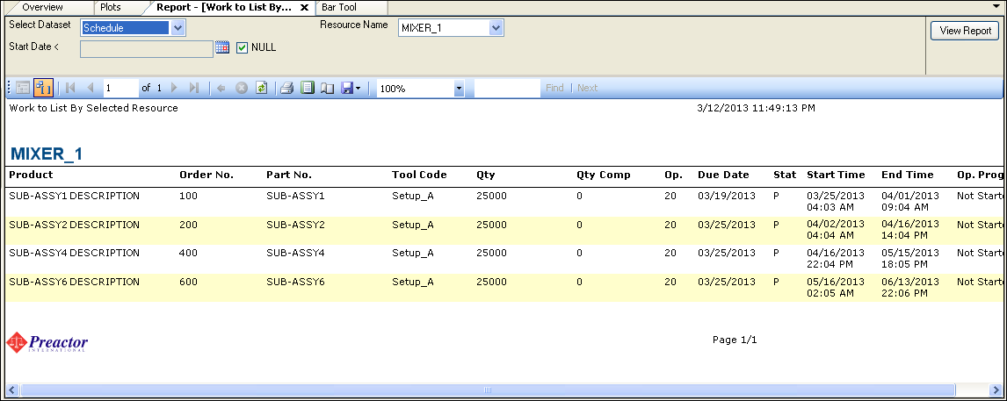
Work to List by Resource (Work Center or Prod Line)
Production Scheduling: What Tool is right for You?

Slide 30
Production Scheduling: What Tool is right for You?
www.qad.com
© 2010 QAD Inc

Slide 31
Presenter Contact Info
Production Scheduling: What Tool is right for You?
Jason Scott
MPS Associates, LLC
(856) 296-6120
jscott@mpsassociates.com
www.mpsassociates.com
Stephen Dombroski
Senior Manager Marketing - Manufacturing Industries
QAD Inc.
(616) 884-0853
sd7@qad.com
www.qad.com

