Slide 1
Excellence in Customer Service For Today & Tomorrow with QAD
QAD Midwest User Group
Stephen Dombroski
Lisa Ozkan
March 2012

Slide 2
Agenda
QAD Midwest User Group
Challenges Facing Service Organizations
Vertical Market Relevance
Overview of QAD’s Service & Support Suite
Recent Enhancements
Customer Story
Future Direction of the Service & Support Suite
Q&A

Slide 3
Challenges Facing Service Organizations
QAD Midwest User Group

Slide 4
Top 5 Goals For CSOs in 2011
QAD Midwest User Group
Source Aberdeen Group September 2010

Slide 5
Business Drivers – to increase revenue
QAD Midwest User Group
Providing top-notch customer service
Maintaining brand loyalty and brand visibility
Reducing service costs and improving the speed of service and support
Managing all aspects of after-sales support and service operations
Seeking to be services-led as a competitive advantage

Slide 6
Operational Drivers
QAD Midwest User Group
Provide responsive and informative customer service experience
Meet and exceed SLAs
Manage services inventory
Both internal and field
Automate field preventative maintenance schedule

Slide 7
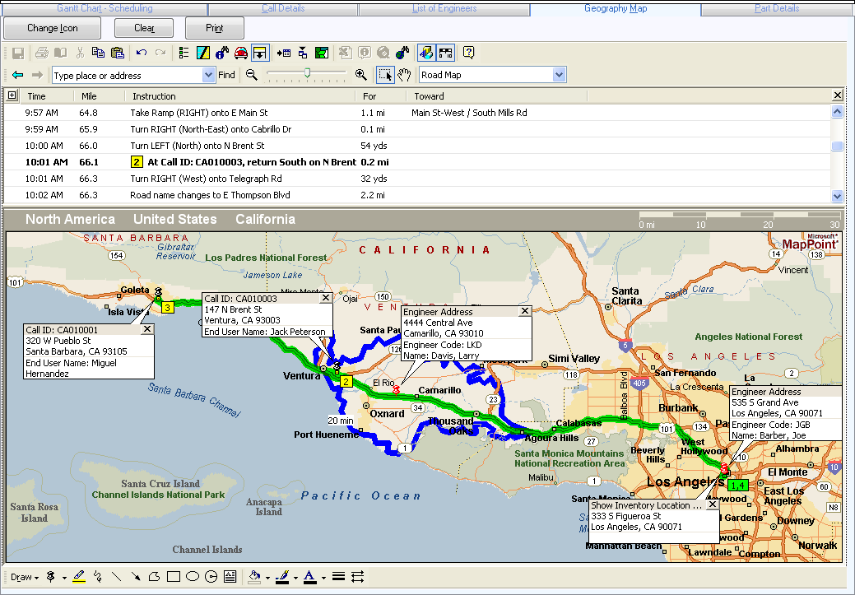
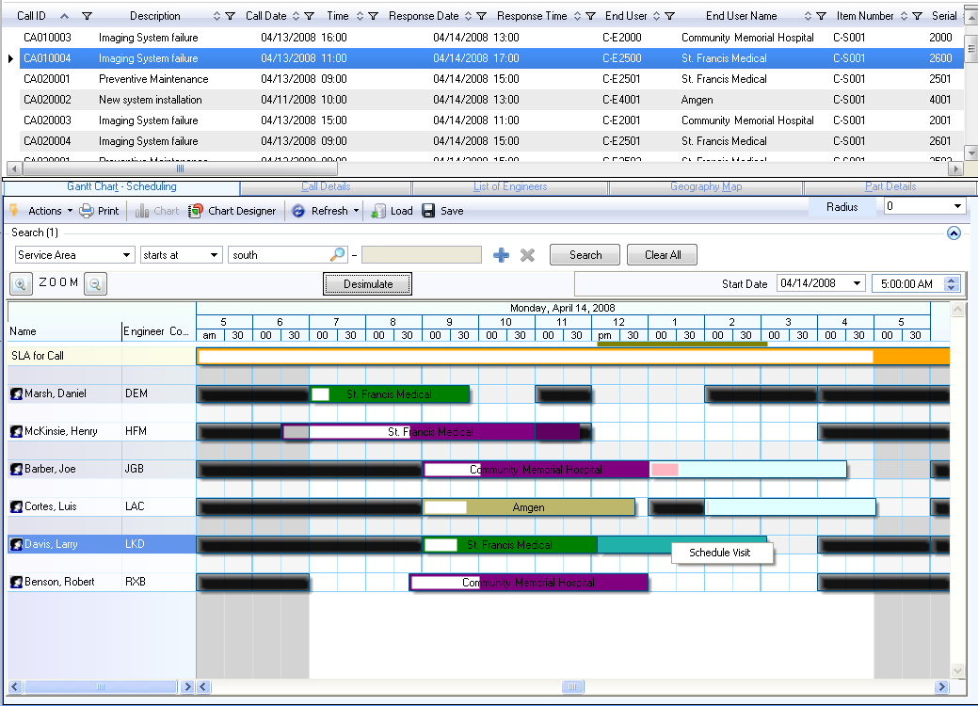
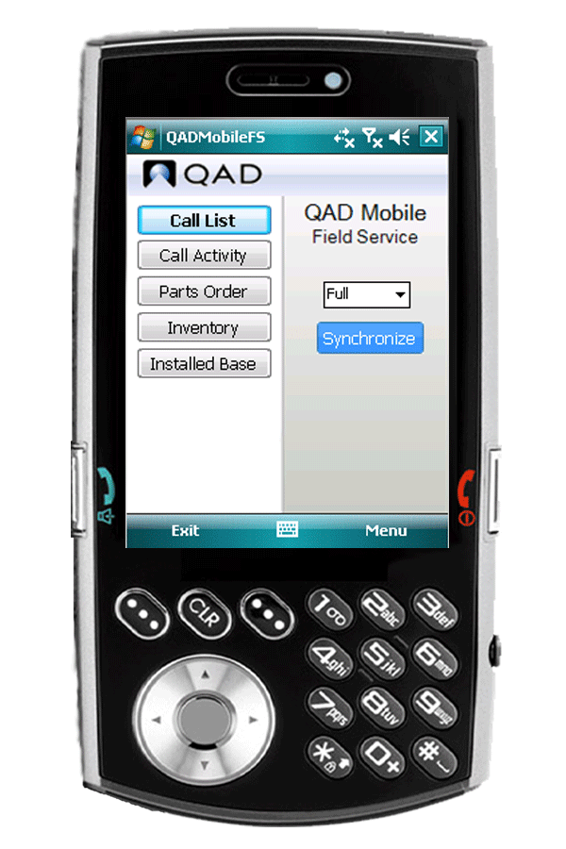
QAD’s Response
QAD Midwest User Group
Tools that enable outstanding customer service
Smart user experience: Role-based interaction
Integrated business processes
Multi-channel access
7

Slide 8
Vertical Market Relevance
QAD Midwest User Group

Slide 9
Vertical Market Relevance
QAD Midwest User Group
 | Capabilities | Auto | High Tech | Industrial | LS (Med Device)
Service and Support | Installed base management |  |  |  | 
 | Returns |  |  |  | 
 | Warranty and claims |  |  |  | 
 | Service contracts |  |  |  | 
 | Call management | · |  |  | 
 | Services parts management | · |  |  | 
 | Cost and revenue tracking |  |  |  | 

Slide 10
Why Select QAD’s Service and Support?
QAD Midwest User Group
Fully integrated solution with QAD EA
Provides a complete view of customer support activities
Role based user interface
Complete solution covering all phases of after sales support
Manages operational and financial activities
Supports global companies

Slide 11
Overview of QAD’s Service & Support Suite
QAD Midwest User Group

Slide 12
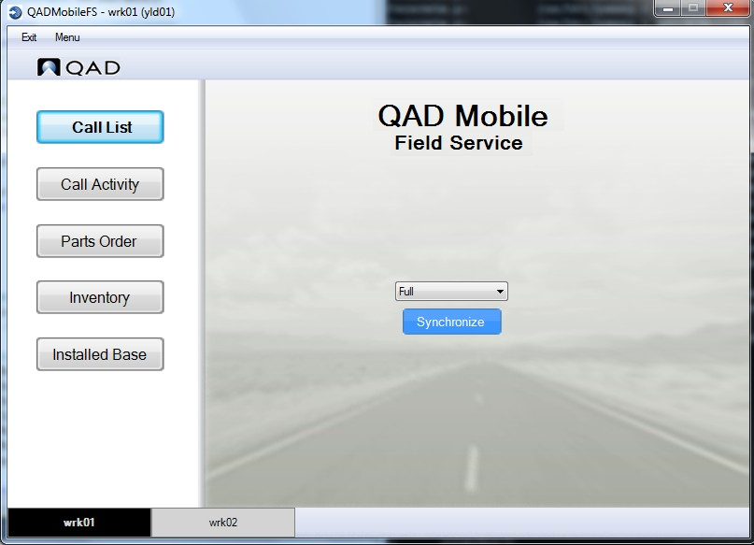
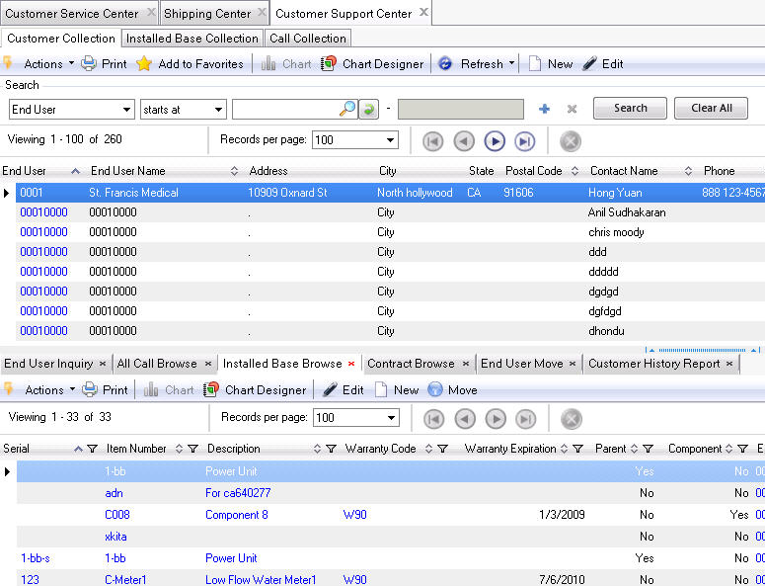
What is it?
QAD Midwest User Group
QAD Service/Support Management (SSM)
QAD Mobile Field Service (MFS)
QAD Field Service Scheduler (FSS)

Slide 13
QAD Service/Support Management (SSM)
QAD Midwest User Group
Installed base management
Warranty and claims management
Service contract management
Returns
Call management
Services parts
Service cost tracking
Service billing

Slide 14
QAD SSM Benefits
QAD Midwest User Group
Accurate service cost and revenue tracking
Installed base tracking after sales to better serve customers
Reduced cost of warranty and contract administration through automation and visibility
Streamlined service-oriented activities (call management, field service, returns)
Optimized engineer time and service inventories

Slide 15
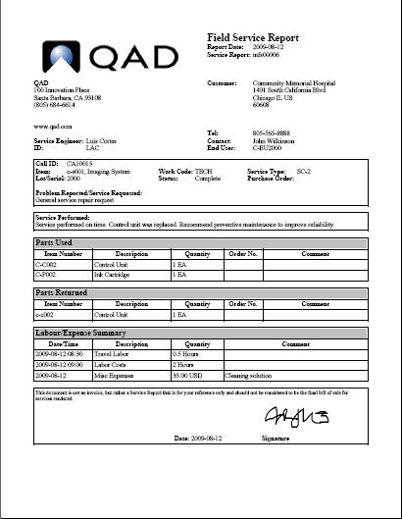
QAD Mobile Field Service (MFS)
QAD Midwest User Group
Designed for your field service engineer
Call assignments
End-user details
Simplified call activity reporting
Parts replenishment
Inventory Inquiry
Installed Base Inquiry
Field Service Report
Capture digital signature

Slide 16
QAD MFS Benefits
QAD Midwest User Group
Improved planned maintenance timeliness by 5%
50 % time saving in processing call activity recording
Increased engineer utilization by at least 5%
Capture proof of service on the spot
Reduced aged parts write-off by 10%
Efficient communication between Engineers, CSR and Logistics
Direct visibility of inventory
Improved service part transfer process

Slide 17
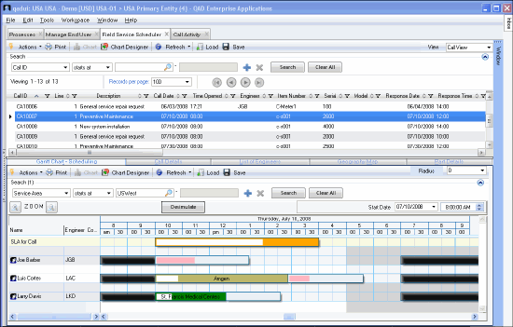
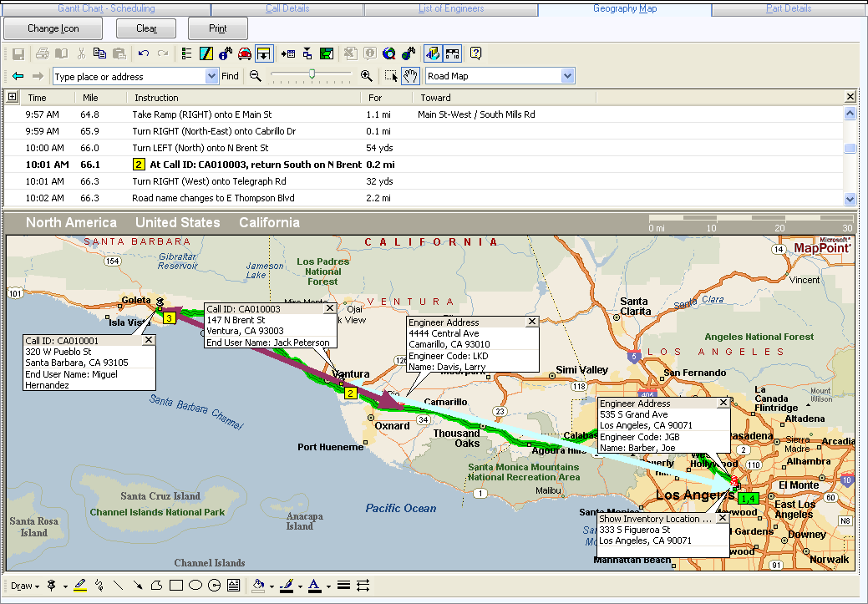
QAD Field Service Scheduler (FSS)
QAD Midwest User Group
Designed for your dispatcher/scheduler
Match engineers and skills to customer needs and visualize each engineer's day in advance
Centralized, integrated scheduling and allocation of people, skills, and service parts inventories
Intelligent mapping and planning for scheduled visits

Slide 18
QAD FSS Benefits
QAD Midwest User Group
Reduced costs and improved productivity through:
Streamlined scheduling
Improved first time fix rates & SLA compliance
Improved identification, allocation and tracking of engineers & materials

Slide 19
Recent Enhancements
QAD Midwest User Group

Slide 20
QAD SSM Enhancements
QAD Midwest User Group
Role-based usability enhancements
Customer Support Center
Process Maps
Operational Metrics
Reports (EE only)
Work flow alerts for calls/visits/MO created
Engineer scheduling enhancements
ISB and call management enhancements
Streamlined service logistics
Depot repair enhancements
20

Slide 21
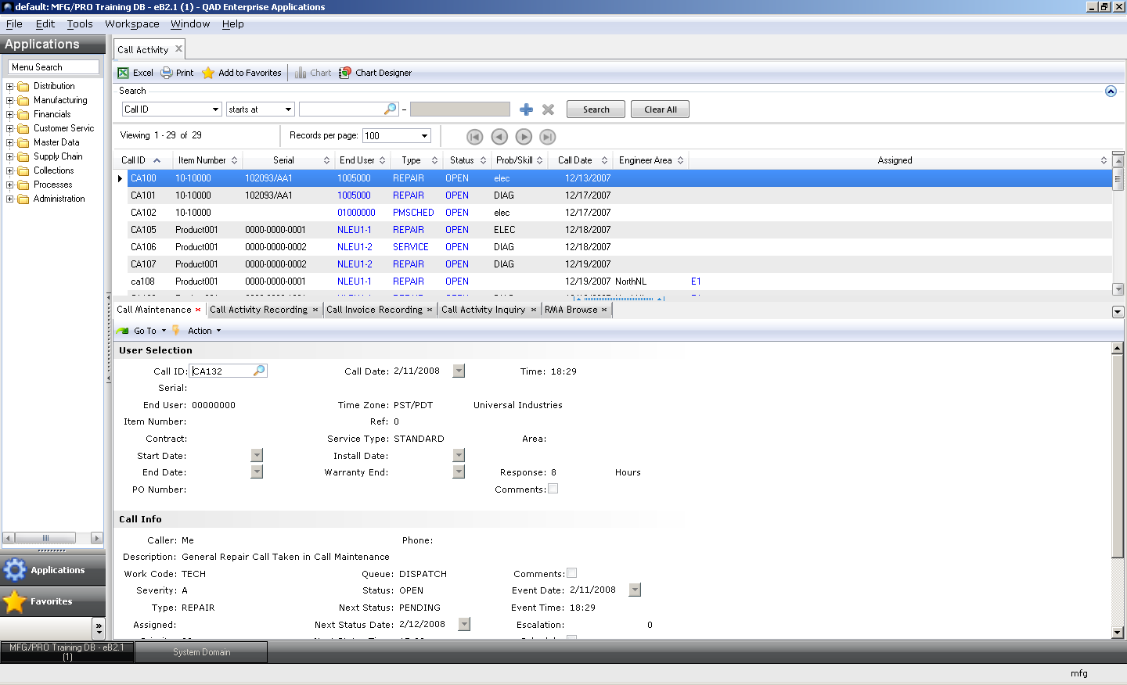
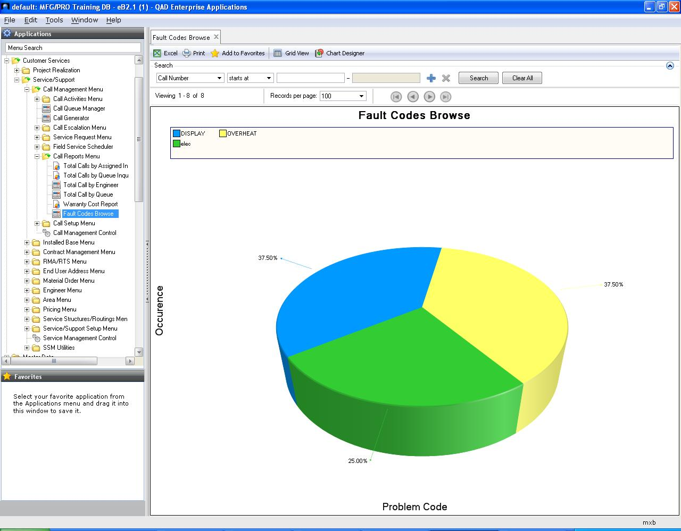
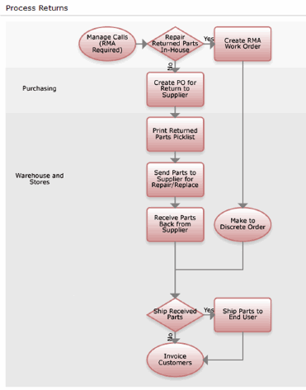
Role Based User Experience
QAD Midwest User Group
Intelligently grouped views and functionality based on needs of various roles within a service organization
Operational service KPIs

Slide 22
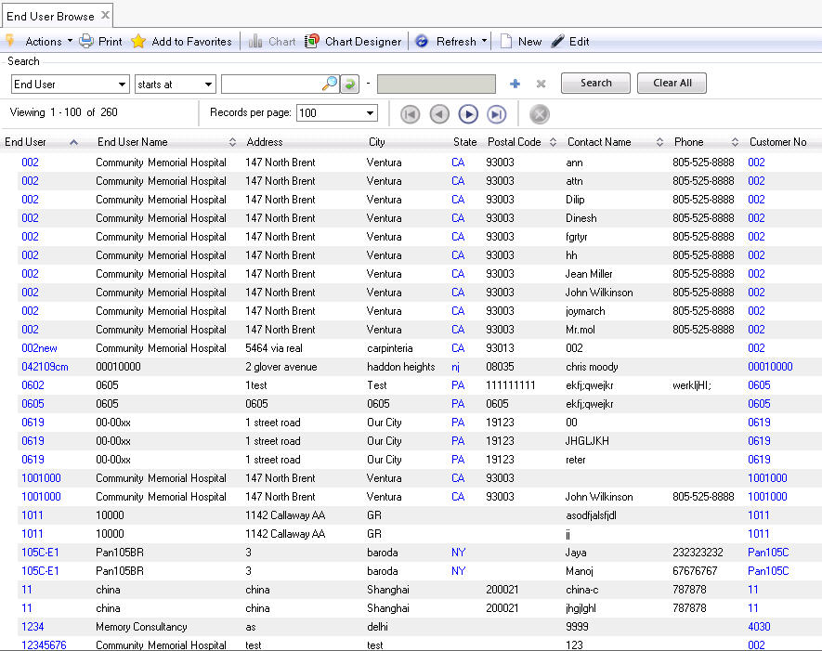
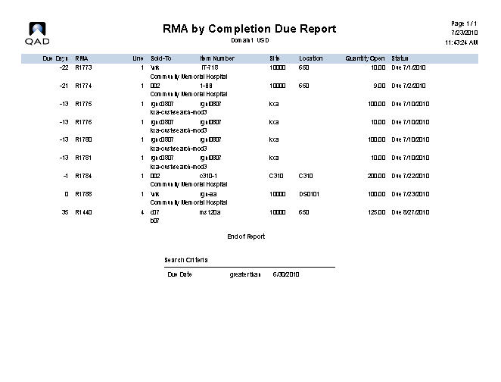
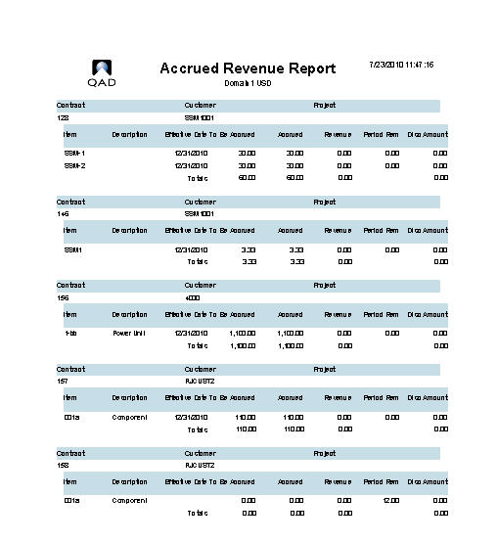
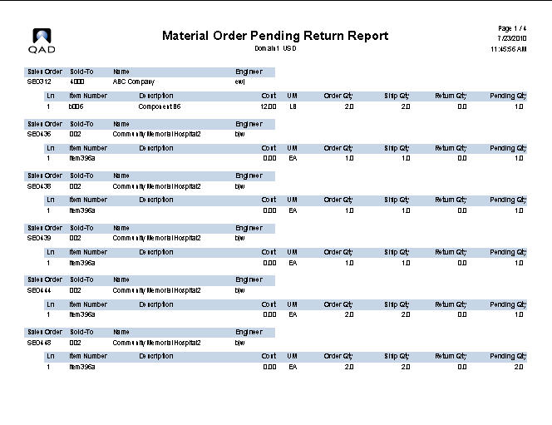
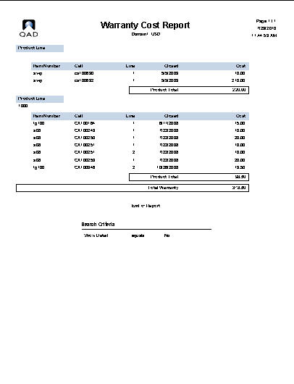
Reporting
QAD Midwest User Group
QAD 2010.1 EE
28 SSM Reports released using Reports Framework (old reports can also still be accessed)
Some of the old reports can be eliminated with browses or combined into single report
QAD 2011 EE+
Customer Management Reporting Bundle
180+ reports/browses

Slide 23
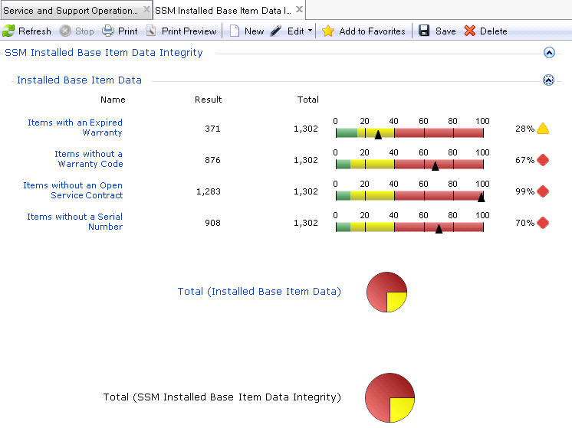
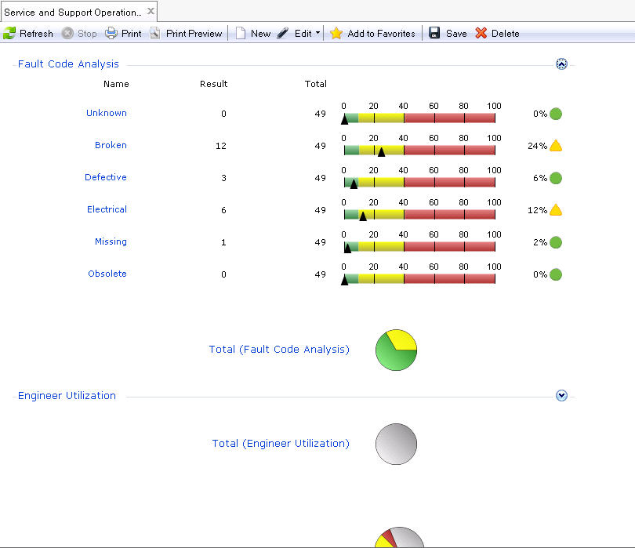
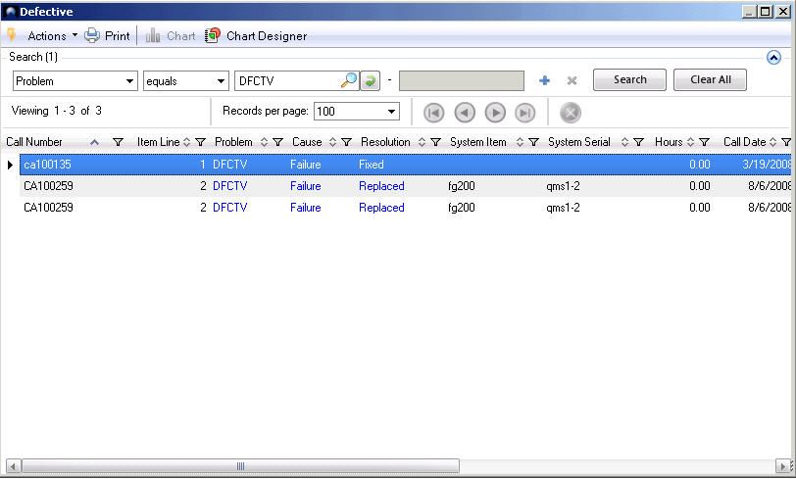
Operational Metrics
QAD Midwest User Group
QAD 2010.1 EE +
Operational and Data Integrity Metrics expanded

Slide 24
Enhanced Reporting and Analysis
QAD Midwest User Group
Version dependency
QAD 2011 EE +
Key enhancement / capability
Part of “Customer Management Reports Bundle”
Uplift of 80+ SSM reports/inquiries to QAD reporting framework

Slide 25
March 2012 Release
QAD Midwest User Group
What is New
Enhanced Reporting and Analysis
Leveraging Reporting & Browse framework
Mobile Field Service Enhancements
Technology update
Visibility and accessibility improvements
User definition

Slide 26
Mobile Field Service Enhancements
QAD Midwest User Group
Version dependency (MFS 3.1)
eB2.1 SP4+, QAD 2009 EE+
Key enhancement / capability
Replace OneBridge Sync Server with Tomcat Web Server
Multiple workspace support for each engineer
Enhanced error log visibility and management
Laptop version of MFS only, until we develop client app for additional devices
User definition supports multiple devices / workspaces per NU

Slide 27
Customer Success Story
QAD Midwest User Group

Slide 28
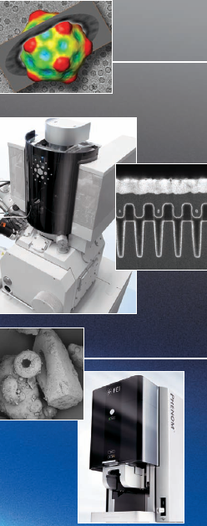
FEI Company
QAD Midwest User Group
Ion-beam systems and electron microscopes for nanotechnology
3 research centers and 50+ service locations in Americas, Europe, and Asia

Slide 29
FEI’s Field Service Challenges
QAD Midwest User Group
Global with inconsistent methods
Lack of workforce scheduling visibility
Accuracy of field service reports
Delays in invoicing and payments
Service call information siloed

Slide 30
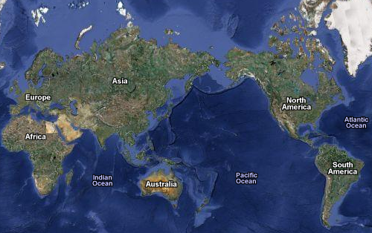
FEI Global Service Organization
QAD Midwest User Group
Europe:
130 FSEs
4 Service Areas
Asia/Japan:
90 FSEs
4 Service Areas
North America:
184 FSEs
10 Service Areas

Slide 31
FEI - Results
QAD Midwest User Group
Reduced data entry time from 5 days to 2 days
Improved planned maintenance inspection timeliness by 5%
Increased field service engineer utilization by at least 5%
Reduced aged parts write-off by 10%

Slide 32
Future Direction of QAD’s Service & Support Suite
QAD Midwest User Group

Slide 33
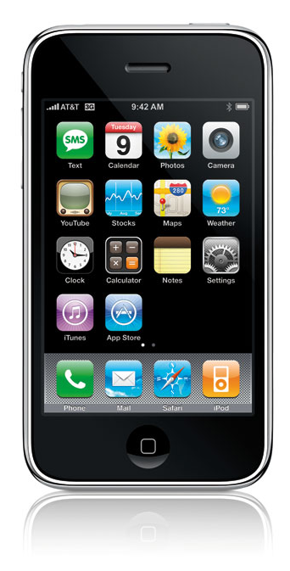
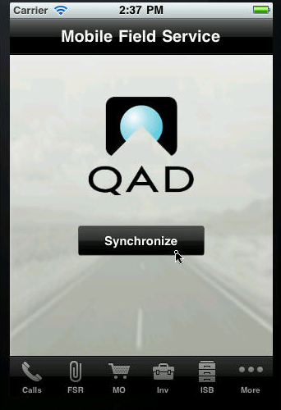
Vision for Service & Support Suite
QAD Midwest User Group
Smart user experience
Adaptable business processes
Access Anywhere Anytime

Slide 34
Web Warranty for Service and Support
QAD Midwest User Group
Warranty Contracts & Analytics
Claim Submittal
Claim Processing
Claim Review & Payment
Parts Usage & Return
Supplier Warranty
Quality
Web, e-mail,
fax, other
Corrective Action
Validate
Approve / Reject
Vendor recovery,
collaborative quality & cost management
Workflow
Credit Memo
A/P
Buy/Sell
Material Transfer
RMA

Slide 35
Service & Support - Future
QAD Midwest User Group
Sale of Service
Auto-create contracts and ISB items from SO fulfillment
Either invoice product and service together on the original SO, or separately
ISB enhancements
Customer defined ISB attributes - Some used to price the item during its sale or the sale of its service coverage
Improved contract pricing
Flexible contract pricing to allow using billing cycles other than just monthly
Apply best pricing to contracts

Slide 36
Service & Support - Future
QAD Midwest User Group
Improved contract renewal quoting and tracking
Auto-create sales quotes for contract renewals with Maintenance Renewal Center
Mobile Field Service
Evaluating tablet and smart phone needs

Slide 37
Summary
QAD Midwest User Group
Deliver outstanding customer service
Reduce operational costs
Improve service revenues
Increase profit

Slide 38
Learn More: www.qad.com/explore

Slide 39
Q & A
QAD Midwest User Group

