Slide 1
QAD .NET UI Browses
How To Get The Most From This Tool
Tris Hopkins
Carlisle Brake & Friction

Slide 2
Outline
Basics
Intermediate
Advanced

Slide 3
Basics
Add tables
Add fields (or columns)
Understand relationship between tables
  Entity Diagrams (how tables relate to each other)
  DB Definitions (what data is in each table)
Know the “big” tables (tr_hist, gltr_hist, abs_mstr, ih_hist, idh_hist)
Use for custom exports
Filtering (hard v. soft criteria)
Add to favorites

Slide 4
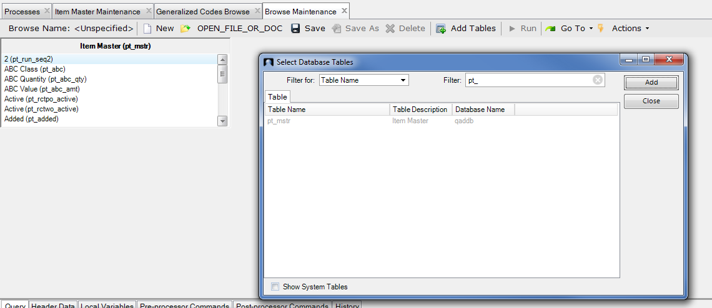
Add Table(s)
Item Master

Slide 5
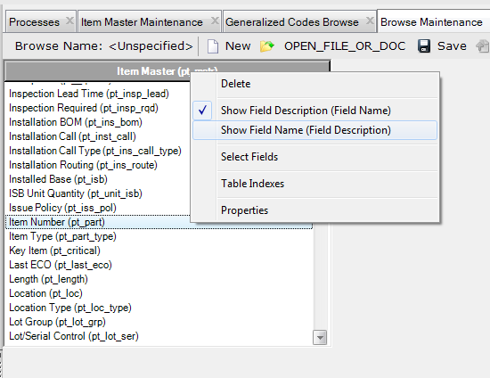
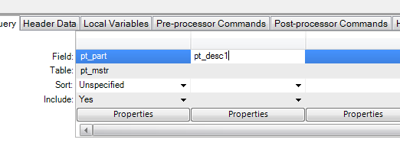
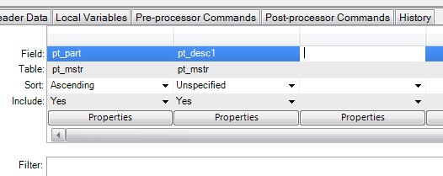
Adding Fields
Item Number
Drag & drop into available column
Tip: Right-Click on table header, choose “Show Field Name” if you are more familiar with the schema
Item Description
You can also click into the “Field” row and type in the field name
The browse builder will auto-fill info when you tab or click out

Slide 6
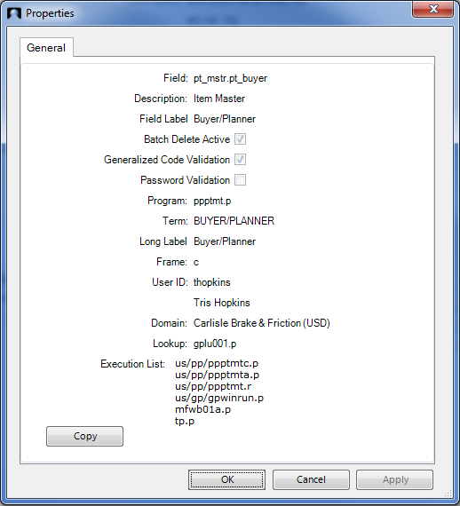
Intermediate: A Bit More Advanced
Linking Tables (Relationship)
You can add pt_buyer (Buyer) to your Item Master browse. But the buyer code is probably not enough. Users would like to see the description that goes with that buyer code. How to find that?
Ctrl-F on Buyer field:
This tells us the name of the field (pt_buyer) and that Generlized Code Validation is active. Therefore, we know that the description is in code_mstr. code_fldname = ‘pt_buyer’ code_value = [Buyer Code] code_cmmt = [Description]

Slide 7

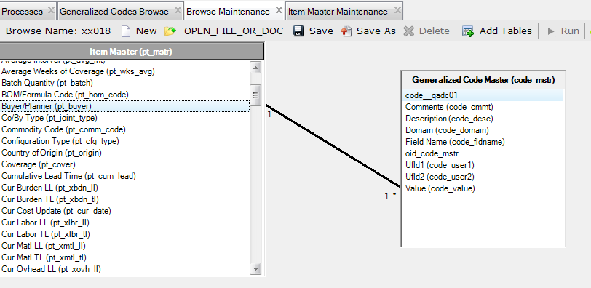
Adding Related Tables
Generalized Codes
Must specify the name of the field name in the browse by entering the criteria into the “Filter” of the browse:
This insures that records from code_mstr are only for buyer data.
Then link the tables using the value of pt_buyer = code_value. Click buyer, drag over to Value in code_mstr.

Slide 8
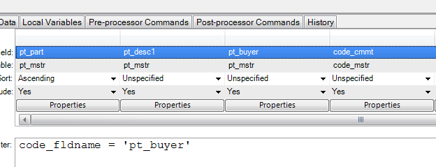
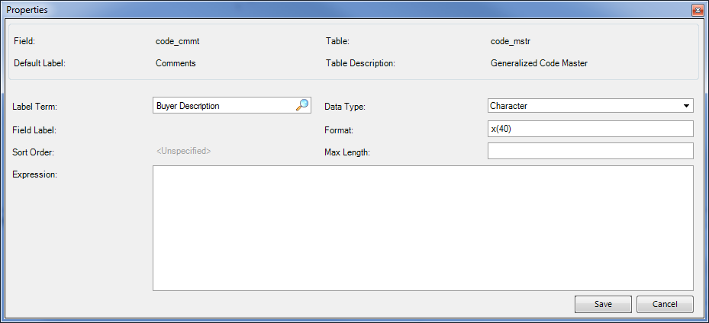
Adding Related Tables (cont.)
Add “code_cmmt” as a column of the browse.
However, when you save/run this browse, you will see that the buyer description column is labeled as “Comments”. User the “Properties” button of the ‘code_cmmt’ field to change this (and other column attributes):

Slide 9
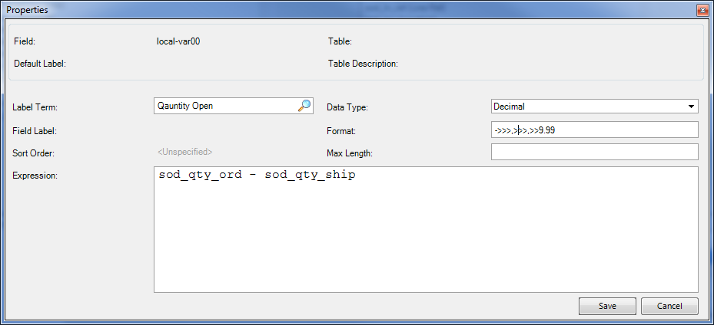
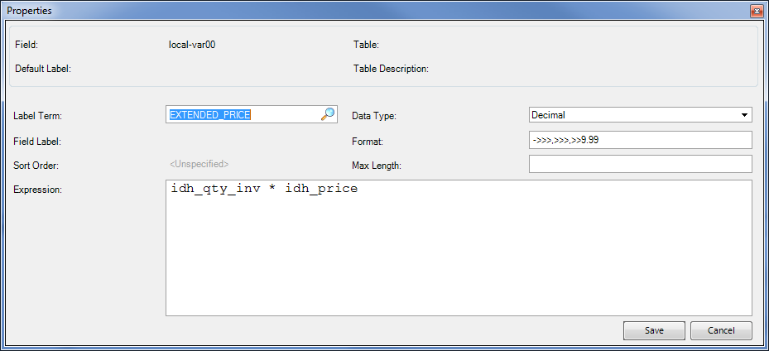
Calculated Fields
Some data is not stored, but rather calculated. For example, quantity open, extended invoice amount.
In Query tab, mouse-over column header, right-click, select “Create Calculated Field”

Slide 10
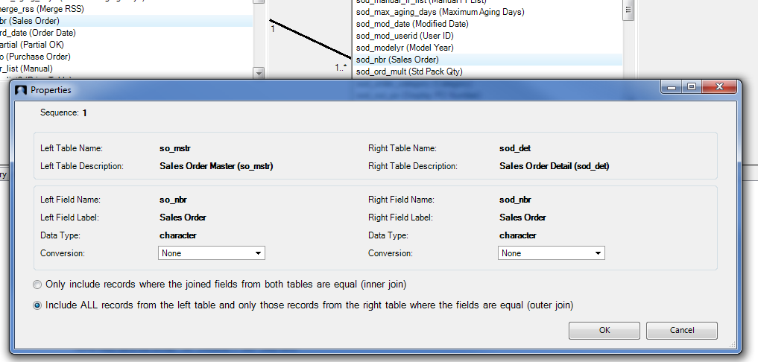

1-to-None, 1-To-1 or 1-To-Many?
Are you certain that a related (child) record will always exist?
First, be certain to drag related fields in the proper direction. For example, drag order header number to order detail number. NOT detail to header.
Default is 1-1 (which is always also 1-to-many)
Double-click link line (or right-click → select “Join Properties”
If you do not change this, then you will not see any order headers that have no order lines.

Slide 11
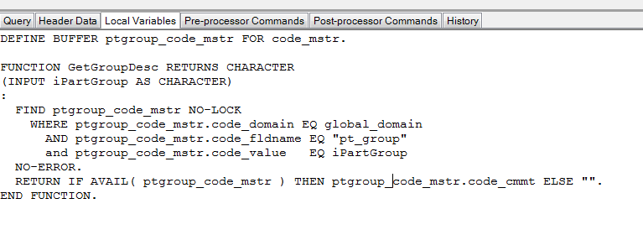
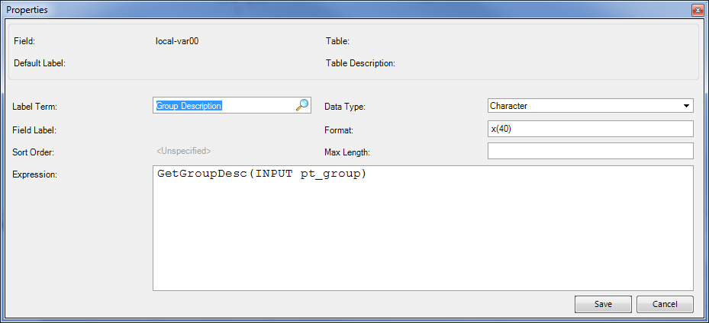
Advanced: Adding Same Table Twice
User requests that we show the item group & description to our item browse
Item group (pt_group) description is also stored in generalized codes (code_mstr). The issue here is that we can only have the code_mstr table added once. So how do we do this? Local Variables / procedures.
[ Right-click to show all tabs ]
First, create the function to find / return the item group description:
d
We define a buffer so that we avoid conflicts with code_mstr being used for buyer.
Always do proper error checking.
Then, right-click query header row, select “Create Calculated Field”. Set column heading text, return type and call your function:
May be better to remove code_mstr, then create a function to get generalized code comments (description)

Slide 12
More Advanced: Kit Quantity On Hand
Request: Show the quantity on hand for a kit that has not yet been assembled. Huh? Yeah, that. We can pick the components of the kit and assemble for shipment same day. We don’t want to tie up the kit component inventory since they can be sold separately.
Add item master as table
Use local variable functions to find and calculate inventory

Slide 13
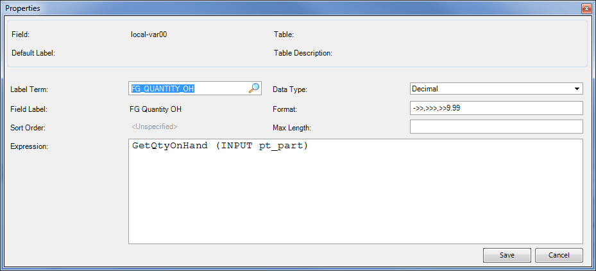
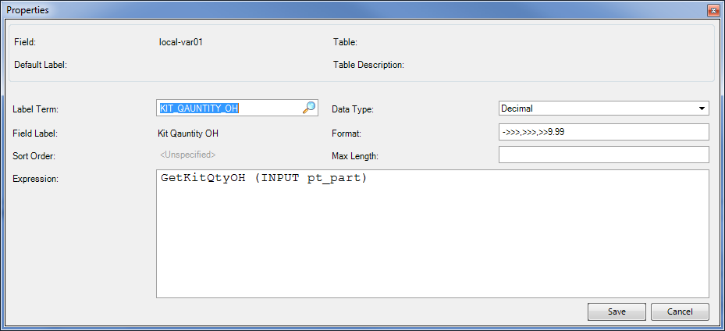
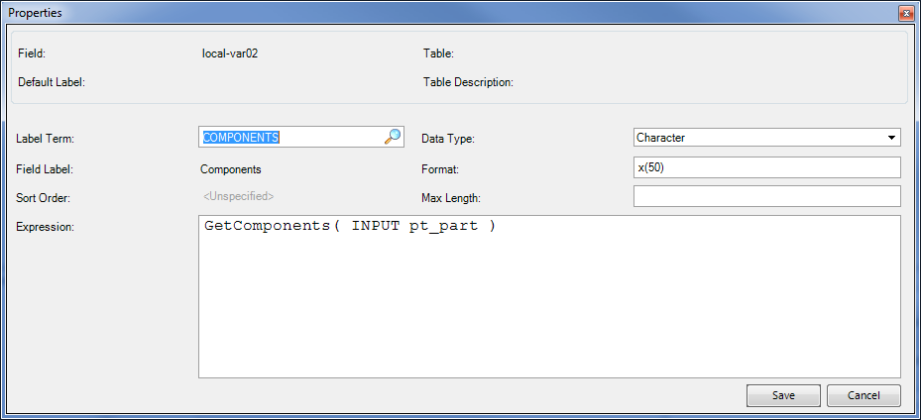
FUNCTION GetQtyOnHand RETURNS DECIMAL (INPUT iPartNum AS CHARACTER):
/* Only pull Qty OH from inventory with AVAIL status */
FOR EACH in_mstr NO-LOCK
WHERE in_domain EQ global_domain
AND in_part EQ iPartNum
:
ACCUMULATE in_qty_avail - in_qty_all (TOTAL).
END.
RETURN MAX(ACCUM TOTAL in_qty_avail - in_qty_all, 0).
END FUNCTION.
/* Function to return the qty on hand of kits that can be built with
* existing component inventory
*/
FUNCTION GetKitQtyOH RETURNS DECIMAL (INPUT iPartNum AS CHARACTER):
DEF VAR comp_qoh LIKE ld_qty_oh NO-UNDO.
DEF VAR kit_qoh LIKE ld_qty_oh NO-UNDO.
kit_qoh = 999999.
FOR EACH ps_mstr NO-LOCK
WHERE ps_domain EQ global_domain
AND ps_par EQ iPartNum
:
/* Only pull Qty OH from inventory with AVAIL status */
FOR EACH in_mstr NO-LOCK
WHERE in_domain EQ ps_domain
AND in_part EQ ps_comp
:
ACCUMULATE in_qty_avail - in_qty_all (TOTAL).
END.
comp_qoh = MAX(accum TOTAL in_qty_avail - in_qty_all, 0).
/* Kit Qty-on-hand is always lowest QoH for all first-level components */
IF comp_qoh LT kit_qoh THEN
kit_qoh = comp_qoh.
END.
IF kit_qoh EQ 999999 THEN kit_qoh = 0. /* this only happens when BoM is missing */
RETURN kit_qoh.
END FUNCTION.
/* Function to get the qty avail on hand of the FG item */
FUNCTION GetComponents RETURNS CHARACTER (INPUT iPartNum AS CHARACTER):
DEF VAR comp_list AS CHAR INIT "".
FOR EACH ps_mstr NO-LOCK
WHERE ps_domain EQ global_domain
AND ps_par EQ iPartNum
:
comp_list = comp_list + (IF comp_list EQ "" THEN "" ELSE ", ") + ps_comp.
END.
RETURN comp_list.
END FUNCTION.

Slide 14
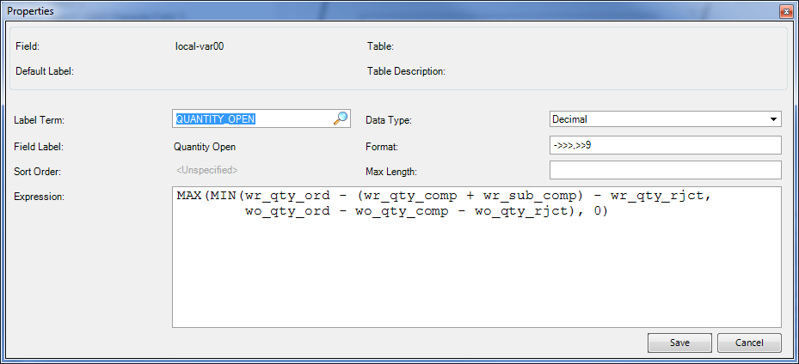
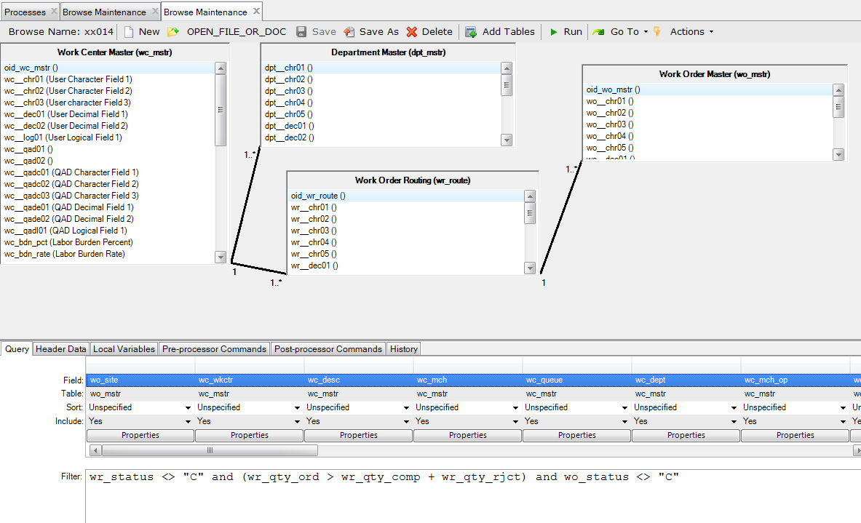
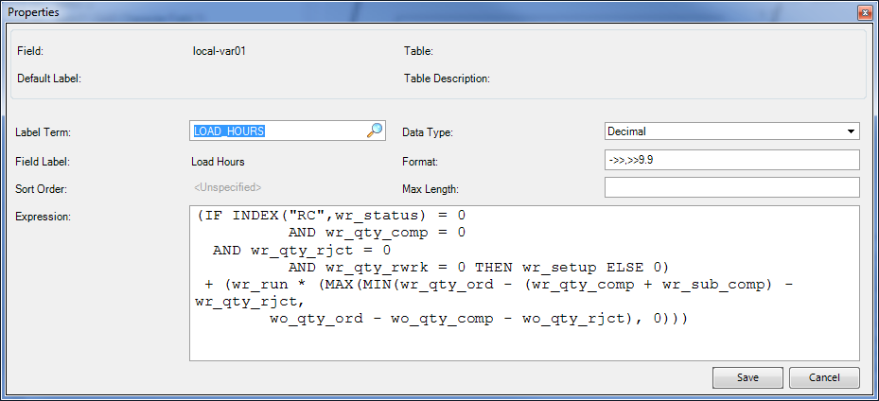
Even More Advanced: Convert Inquiry To Browse
Work Center Load Detail Inquiry (24.16, crwciq02.p)
Review source (should have source to all reports / inquiries)
Replicate as close as possible in browse

Slide 15
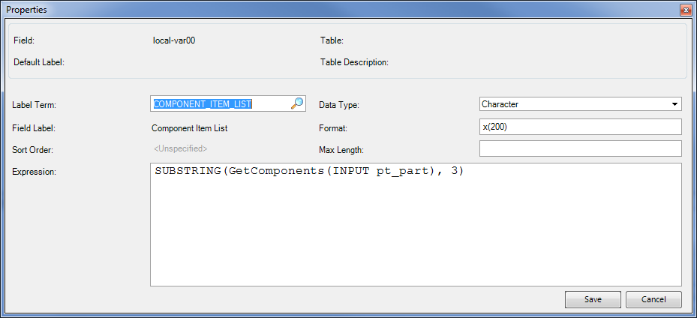
Using Recursion To Display BOM Components
Be very careful with recursive functions. Step 1 is always to identify the return condition. Eg, the condition at which you simply return a value rather than calling the function again.
Simple browse to show all components of a finished good as a comma-separated list.
Add pt_mstr table, then a few fields as columns to display.
Create a calculated field setup as shown:
In the “Local Variables” tab, add this function:
FUNCTION GetComponents RETURNS CHARACTER
(INPUT iPart AS CHARACTER):
def var comp_list as char no-undo.
FOR EACH ps_mstr NO-LOCK
WHERE ps_domain EQ global_domain
AND ps_par EQ iPart
AND (ps_start LE TODAY OR ps_start EQ ?)
AND (ps_end GE TODAY OR ps_end EQ ?)
:
comp_list = comp_list + ", " + ps_comp + GetComponents(INPUT ps_comp).
END.
RETURN comp_list.
END FUNCTION.

Slide 16
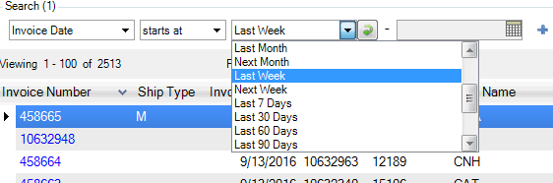
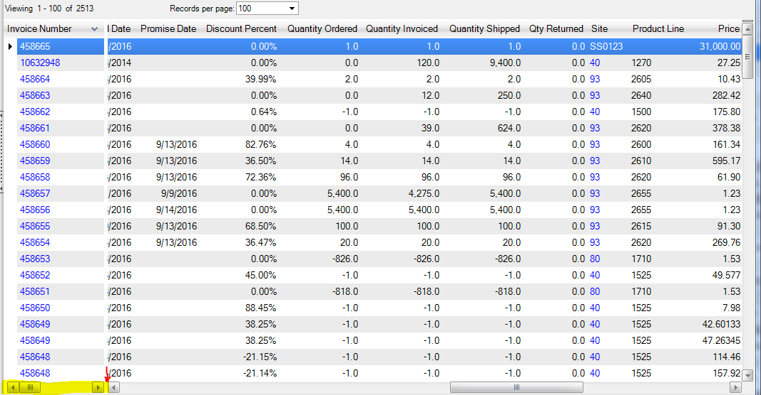
Tips & Tricks
Encourage usage of favorites with soft-search filters to allow browses to open more quickly
Especially useful for ever-growing tables like invoices, inventory transactions, shippers
Freeze left columns
Move cursor to just immediately left of scroll-left arrow at bottom-left of browse window. When it changes to a splitter icon, drag right.

Slide 17
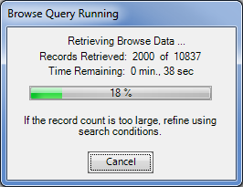
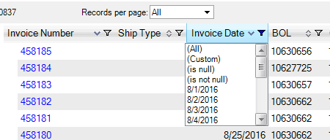
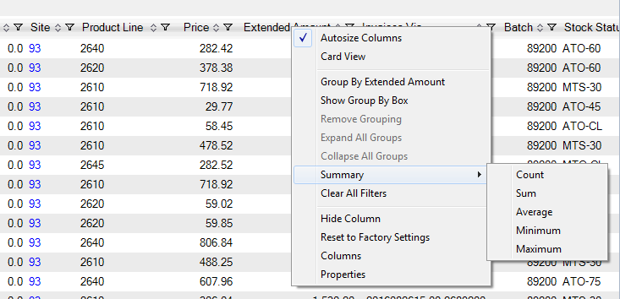
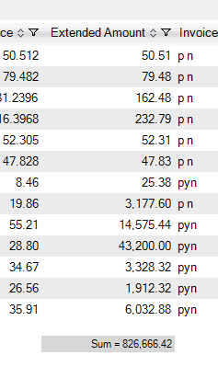
In-Browse Filtering, Aggregates, Grouping
To enable column filters, grouping and aggregates, you must retrieve all records.
! Careful not to bring your system to its knees with a HUGE dataset !
Can now use filter icon at top of each column
Aggregates also enabled. Count any column,
Only numeric data can be summed, averaged,
minimum and/or maximum

Slide 18
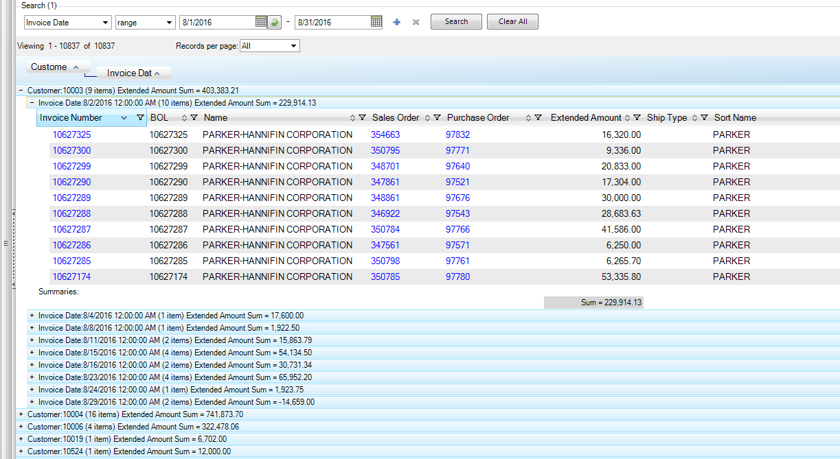
Continued …
Grouping. Right click over column, choose “Group by …”. Or choose “Show group-by box”. You can then drag column headings into the group-by box and get sub-totals for each grouping.
Invoice total example

Slide 19
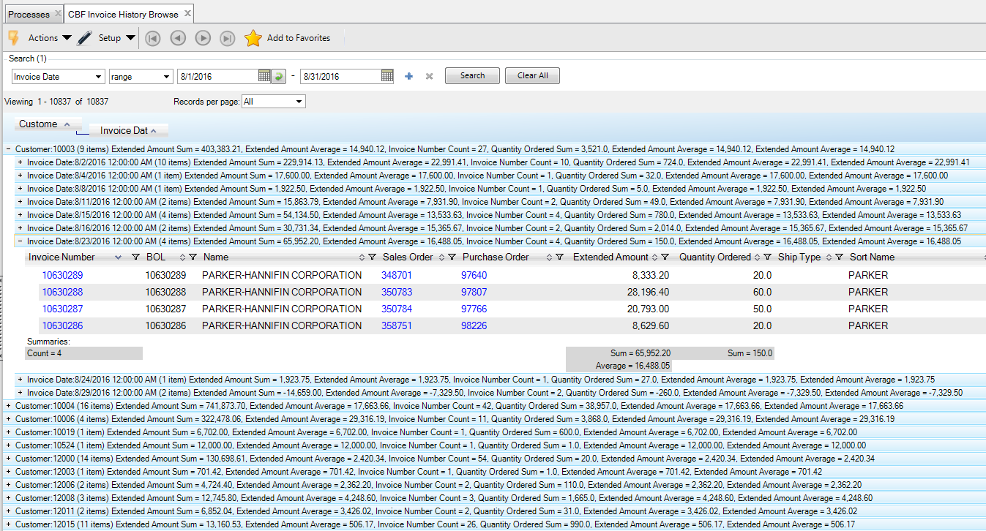
Can get as complicated as you want with Aggregates

Slide 20
Q & A
Use dev/test environment to create browse.
Actions → Export
Then, in production, Actions → Import
to migrate browse to production env.
Use “History” tab for documentation
Recursion anyone?
Any other questions?

